Slide 1
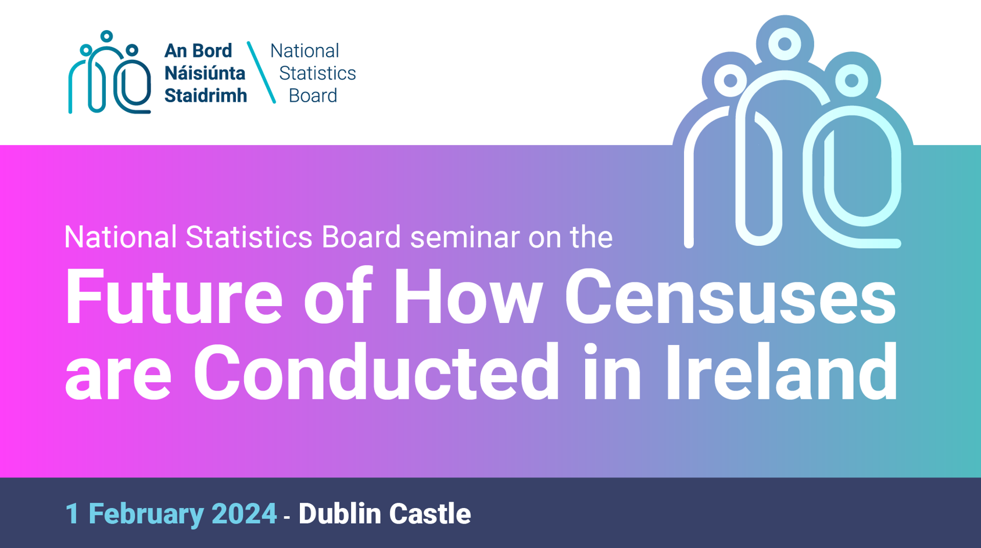

Slide 2
Beyond Census 2021: The Future of Population and Migration statistics in England and Wales
Jen Woolford, Director of Population Statistics
Feb 1st 2024

Slide 3

Census First Release 2021 – England and Wales
97% response rate
7th place on Twitter
trending (June 28, 2022)
88.9% household responses on line
c56% online responses by mobile phone
2150 pieces of media
coverage
104.1m
social media users reached
> 10,000
stakeholders engaged

Slide 4






Quality Assurance Approach
Coverage survey
Validation against comparators
Top quality fieldwork
Local Authority Collaboration

Slide 5
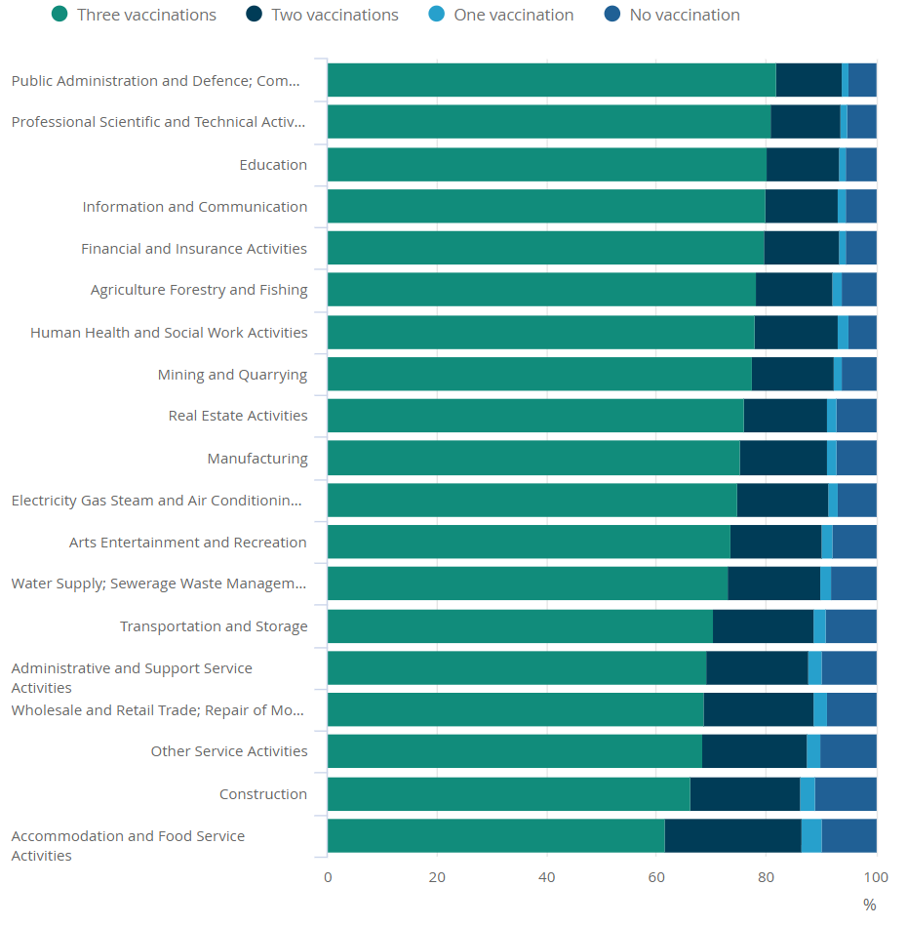
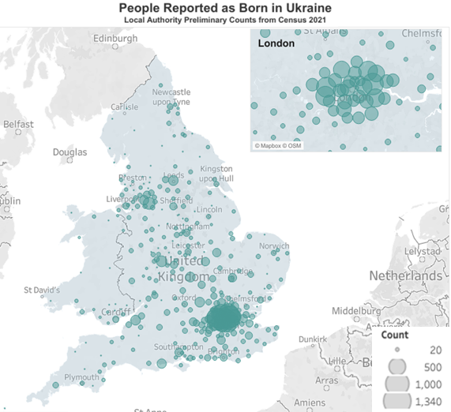
Early policy impact of Census
Covid-19 Vaccination coverage by Industry
Ukrainian Diaspora in England and Wales
Third coronavirus (COVID-19) vaccination coverage was highest in the public administration and defence; compulsory social security industry section. Crude vaccination rate by industry section and vaccine number in people aged 18 to 64 years, England, 28 February 2022. Source: Office for National Statistics - Public Health Data Asset, NHS England - National Immunisation Management Service.
The table and map show persons recorded as born in Ukraine organised by regions using preliminary 2021 Census data as above. These are not official Census estimates, but preliminary census response counts of usual residents that responded to Census 2021 and listed Ukraine as their country of birth. Data available here.

Slide 6

Describing users through personas
Technical user
Expert analyst
Policy influencer
Information forager
Inquiring citizen
Passive citizen
I like to play with data and technology
I live and breathe data and statistics
It’s hard to find the information I need
I have a need to find trustworthy data and insight
I want to form my own opinion based on fact
I rely on the media to be kept informed

Slide 7
Describing users through personas
Technical user
Expert analyst
Policy influencer
Information forager
Inquiring citizen
Passive citizen
Give me the data / let me explore
Help me understand
I like to play with data and technology
“I live and breathe data and statistics
It’s hard to find the information I need
I have a need to find trustworthy data & insight
I want to form my own opinion based on fact
I’m informed via the media

Slide 8
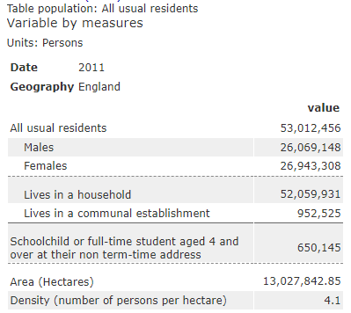
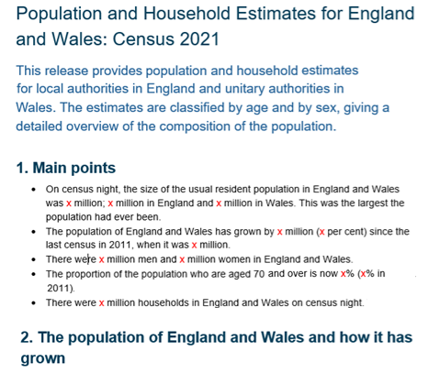
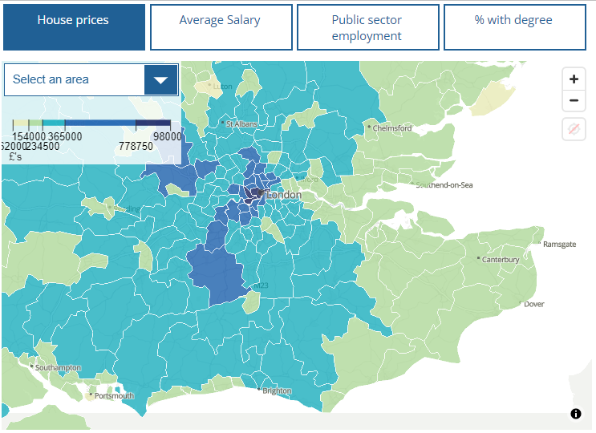
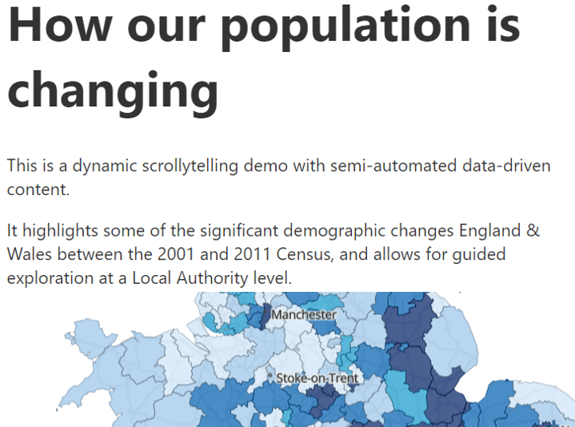






Products for different users
Data
Commentary
Exploratory
Explanatory
Personas
Technical user
Expert analyst
Policy influencer
Information forager
Inquiring citizen
Passive citizen
These products will be accompanied by supporting information around quality and methods

Slide 9
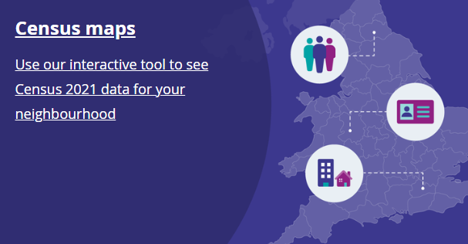
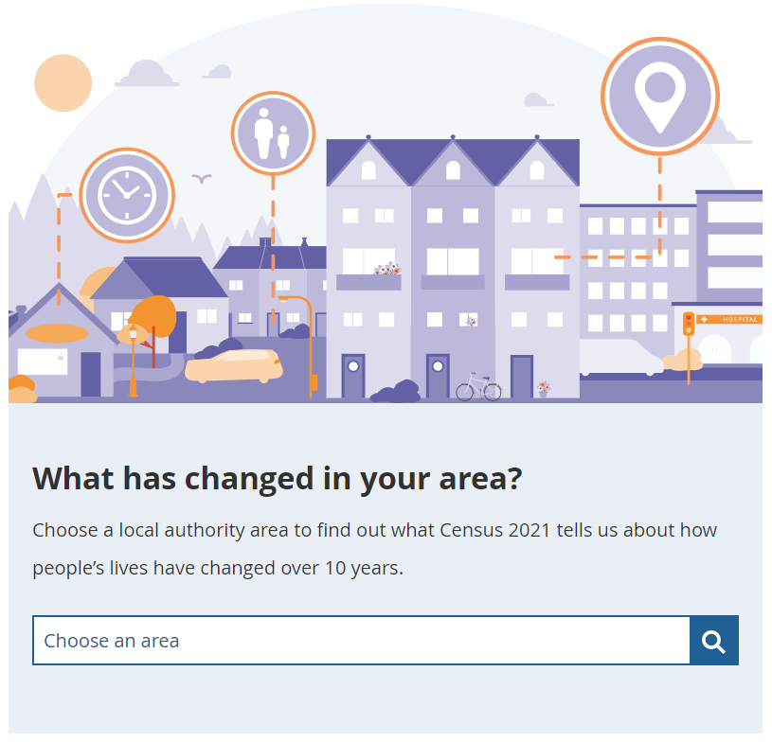
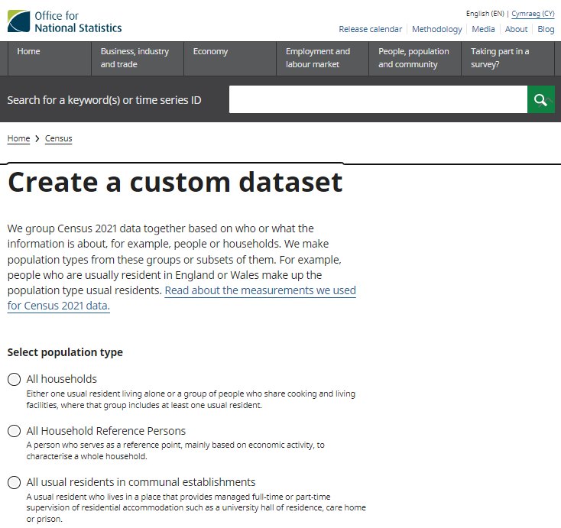

Census products
There are a range of interactive content and tools available on the ONS website.
Custom data sets
Census maps
Change over time reports
Area profiles
How the population changed where you live: Census 2021 ‘scrollytelling’ article
The story of the Census ‘scrollytelling’ article
Census 2021 dictionary

Slide 10
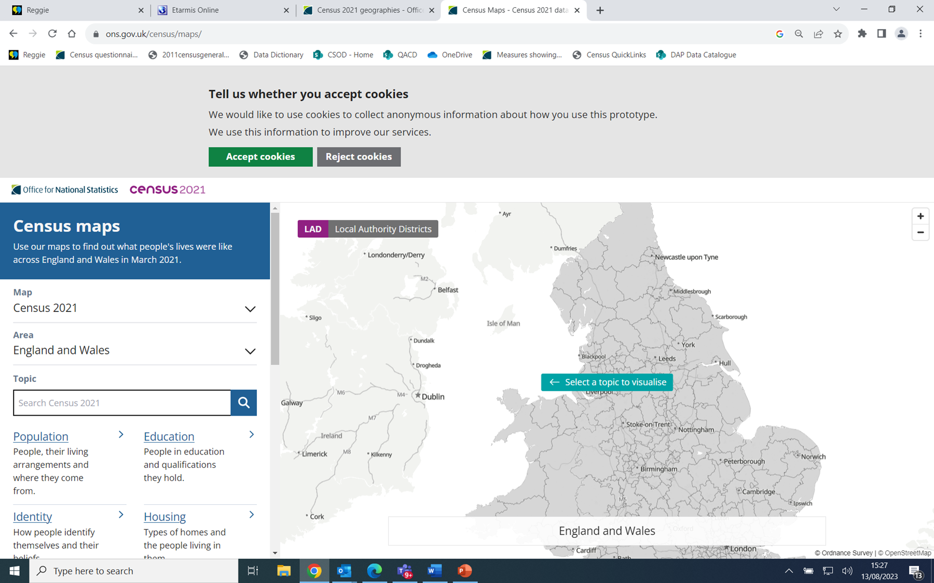
Census maps

Slide 11
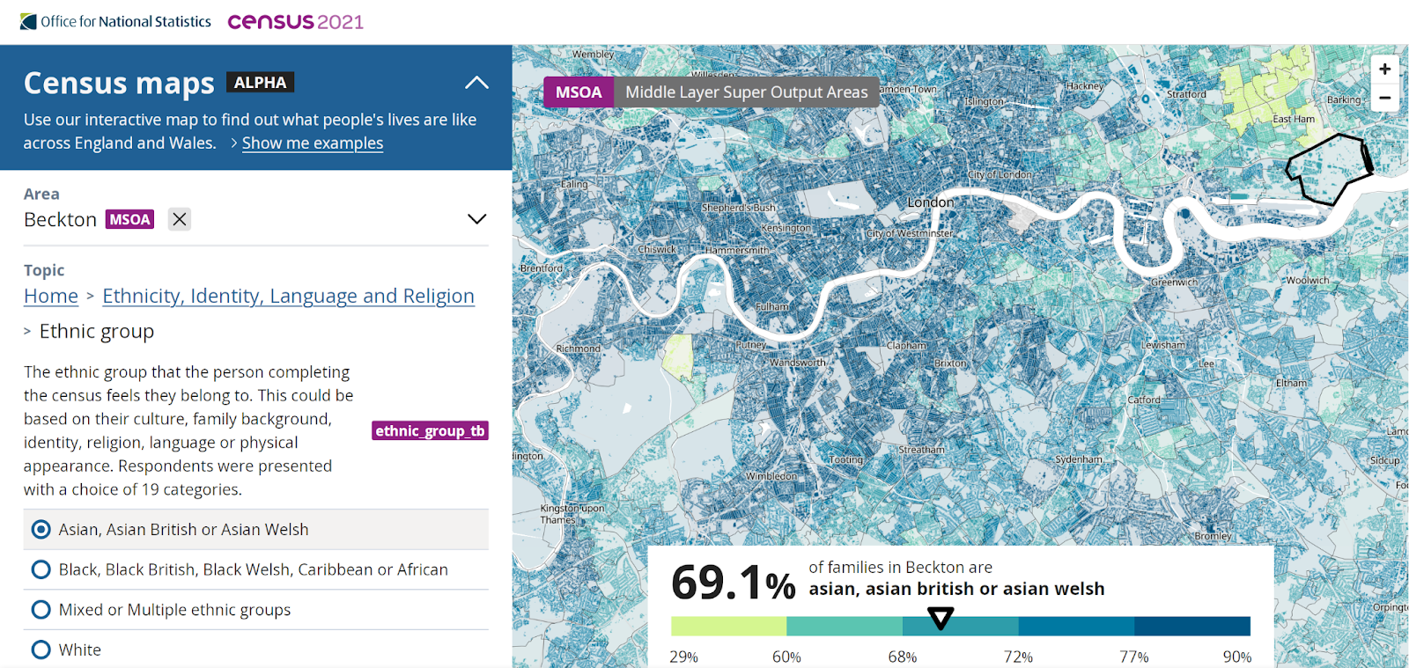

Slide 12
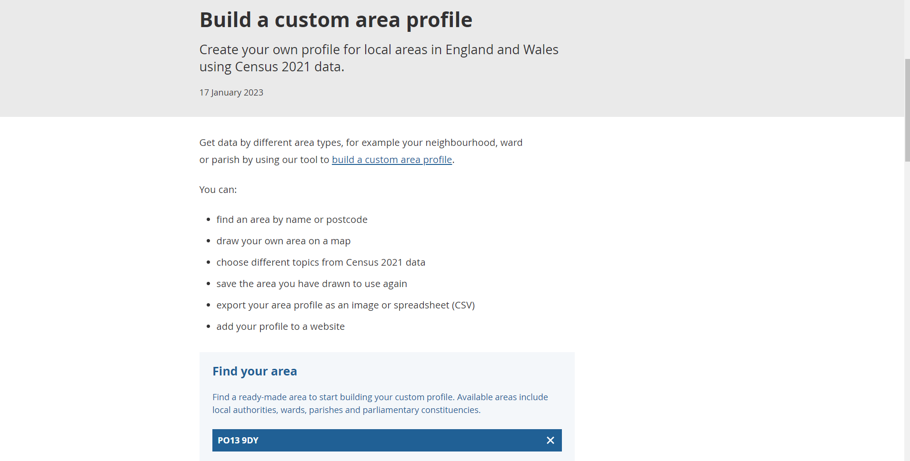
Build a custom area profile

Slide 13
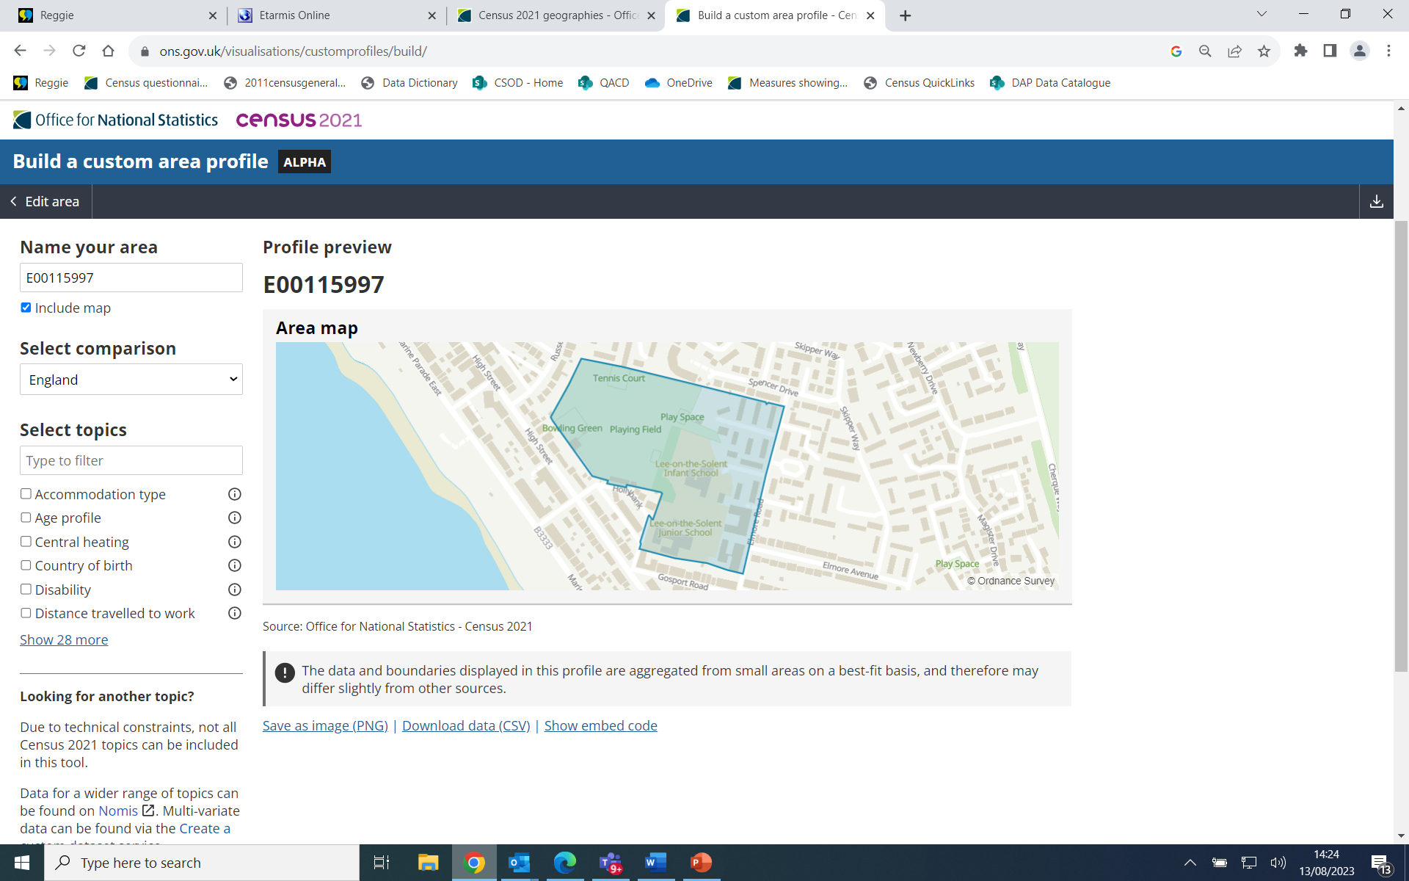
Profile preview

Slide 14
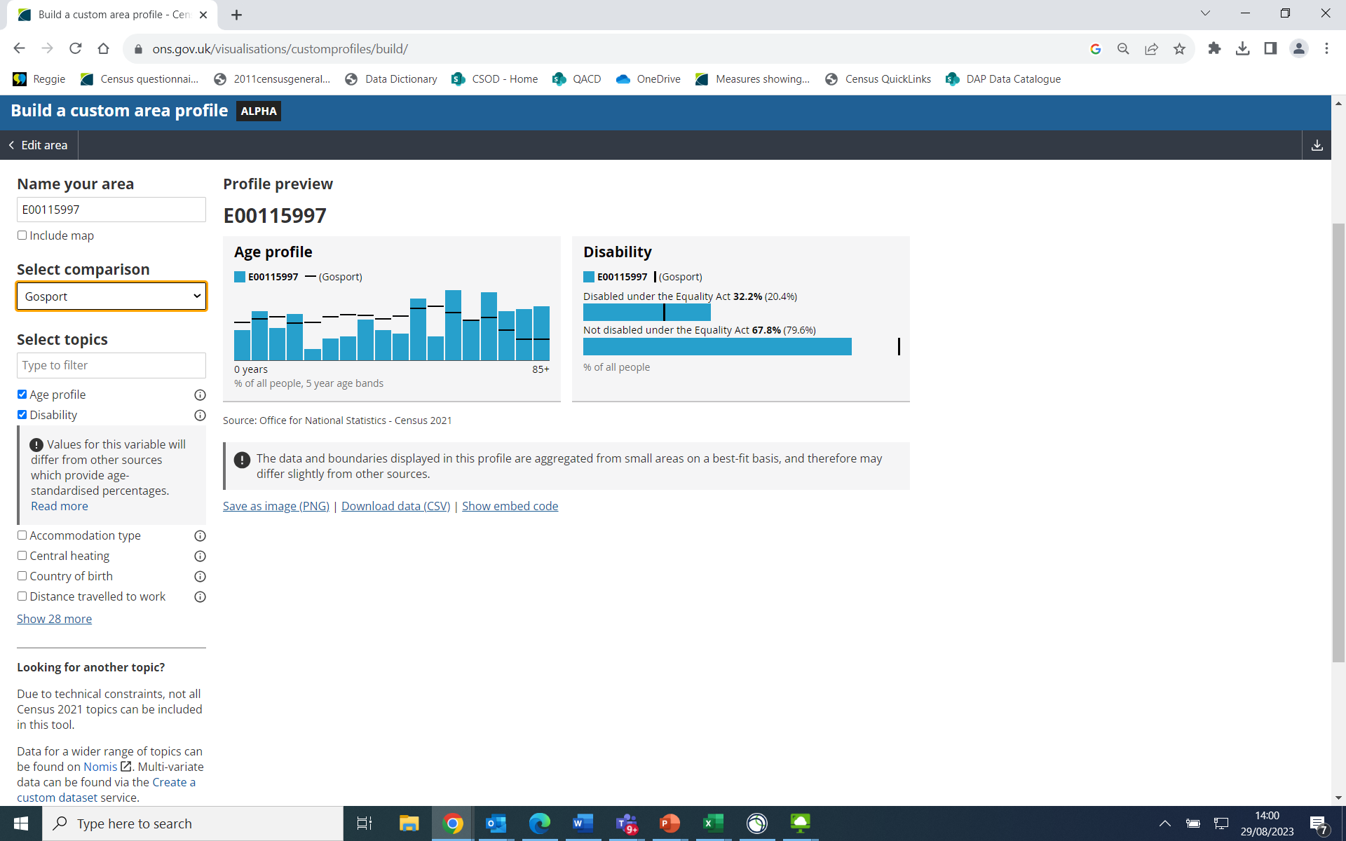
Profile preview with local authority comparison

Slide 15
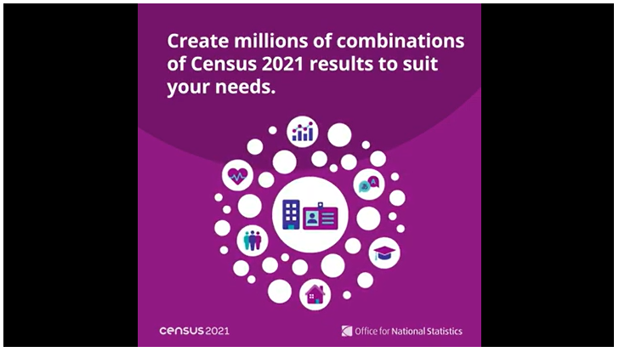
Create a custom data set
Simply select a population to get started. These include usual residents, households and communal establishments.
From there, you can change the geography of your dataset and filter the data by sex and age. You can also add as many variables as you want.
Play the create a custom data set video
Read the blog on how to create a custom data set

Slide 16
The Future of Population and Migration statistics in England and Wales

Slide 17




Future Population & Migration Statistics System
Strategic vision: More frequent, timely and inclusive statistics about the population and its characteristics
A social statistics system that shapes our understanding of society and individuals.
A system to create and share statistics that is sustainable and future proof.
A broad, flexible range of outputs and products to respond to user needs and questions of the day.
Administrative data will be at the core of this system.

Slide 18




The transformed outputs will include
National to local
Population and Migration Statistics
Understanding demographic change and respond to challenges
Population sub-groups and characteristics
Reflecting the diversity of populations to local levels
Housing, accommodation and living arrangements
Understanding
who and how people live together in our society
Outcomes
Data assets that allow us to understand population life journeys and outcomes

Slide 19
Population estimates based on administrative data
Administrative data
Linkage and de-duplication
Statistical Population Dataset
Coverage adjustment
Population Model
Admin based characteristic estimates
Admin based population estimates (ABPEs)

Slide 20
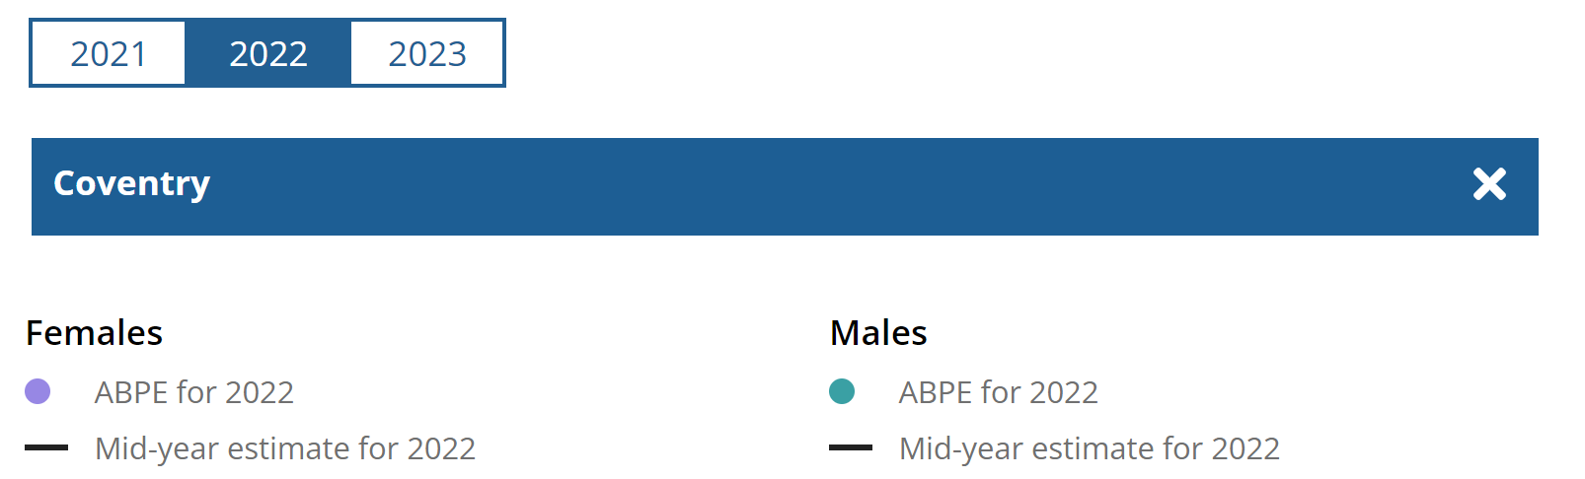
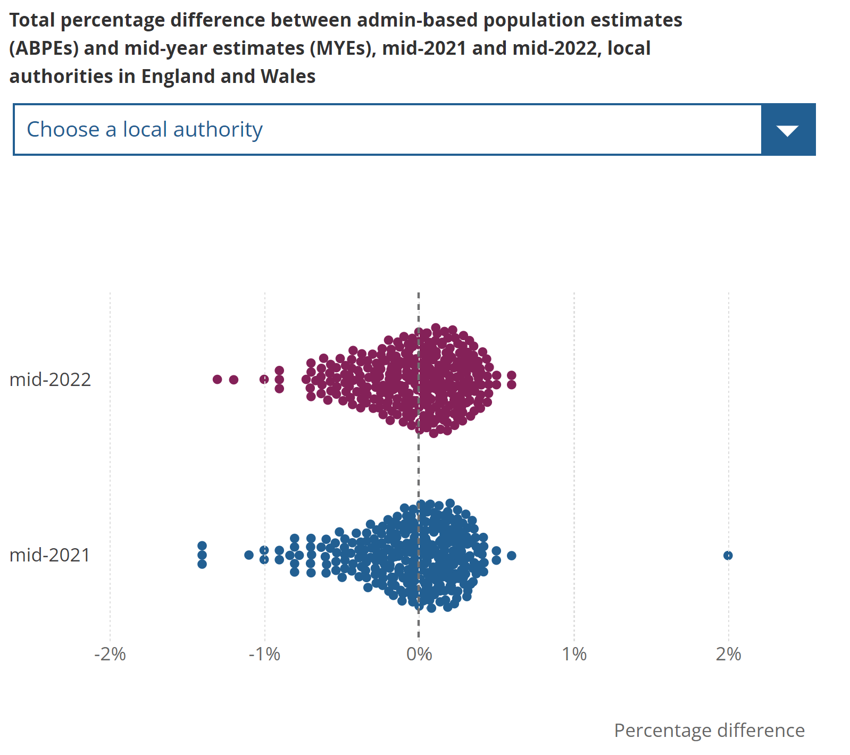
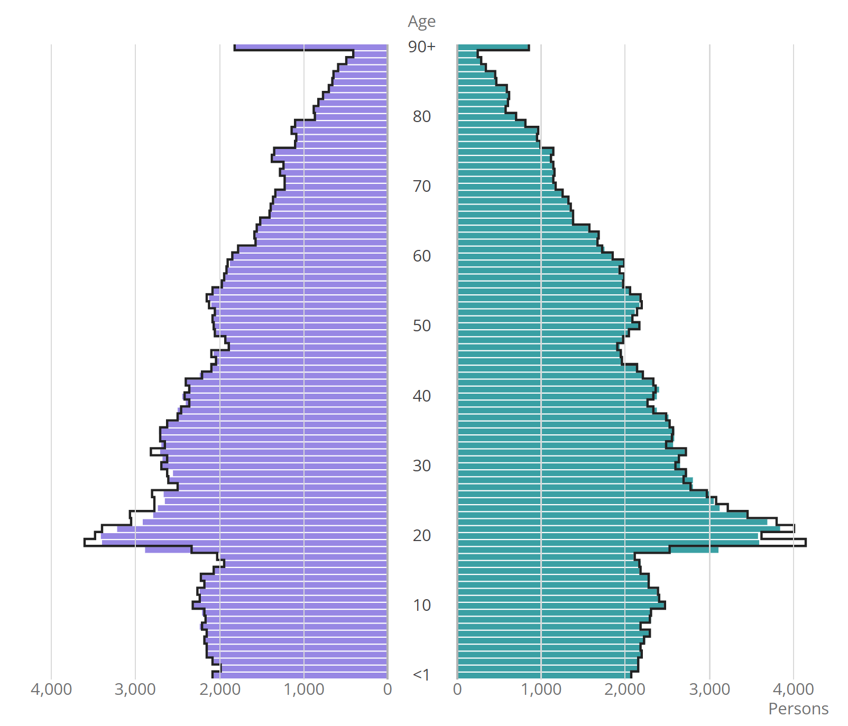
MYEs v ABPEs

Slide 21
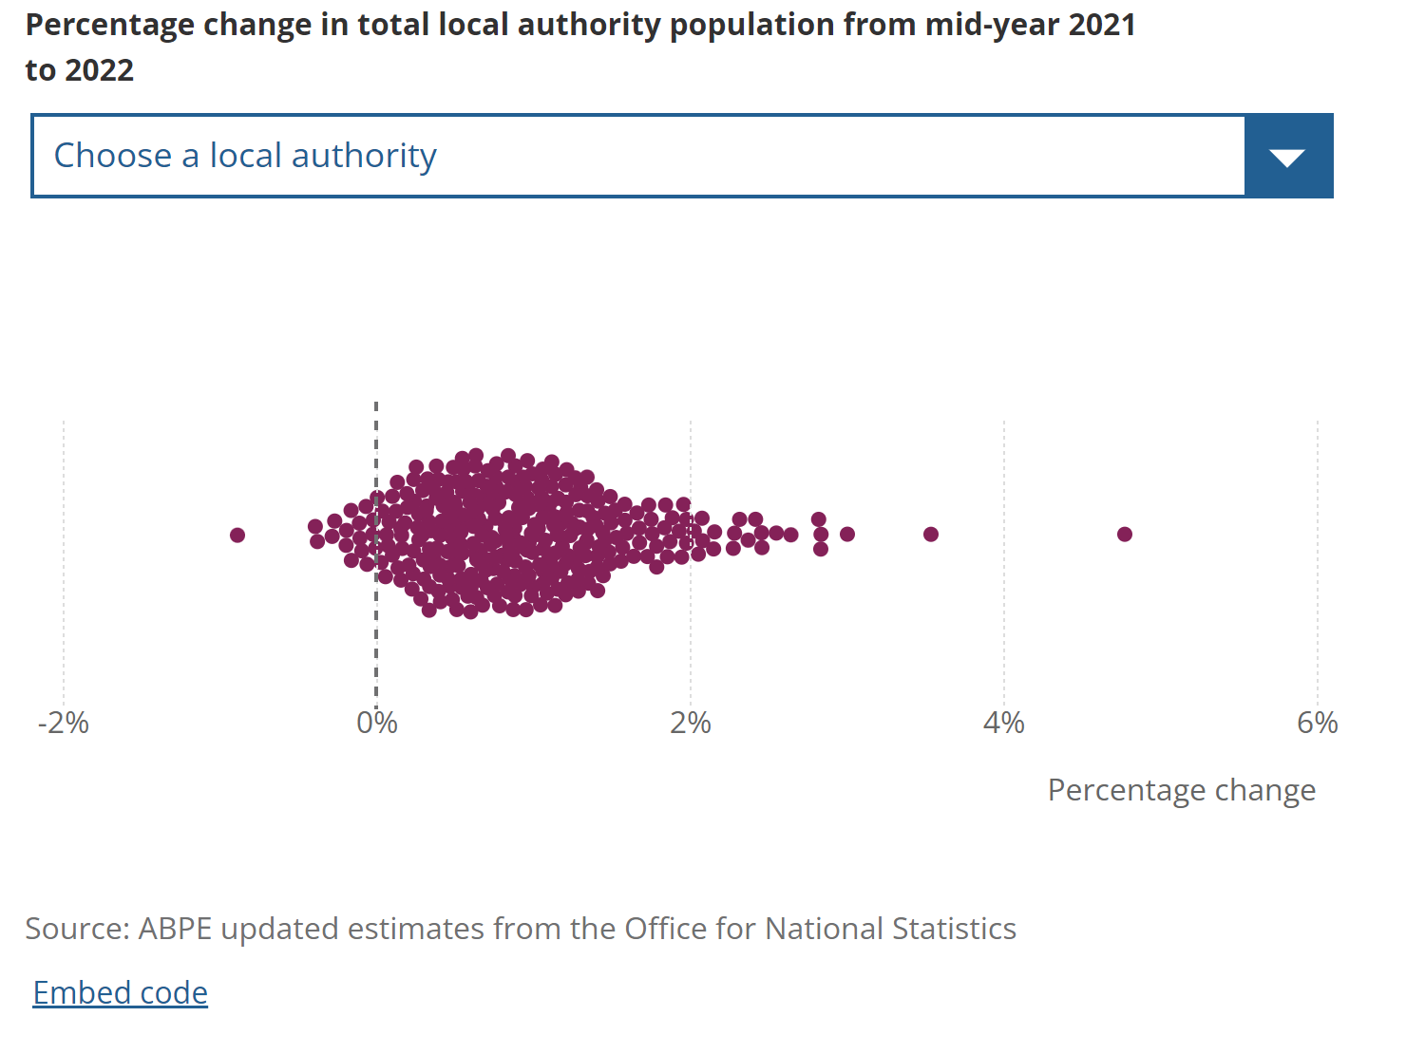
Admin-based population estimates change between 2021 and 2022
As expected, the largest population growth are seen in London local authorities
From left to right:
South Staffordshire (-0.9%)
Lincoln (-0.4%)
Ipswich (-0.4%)
From left to right:
Newham (+3.0%)
Westminster (+3.5%)
Tower Hamlets (+4.8%)
We have produced provisional estimates 4 months earlier than we do in the current system

Slide 22
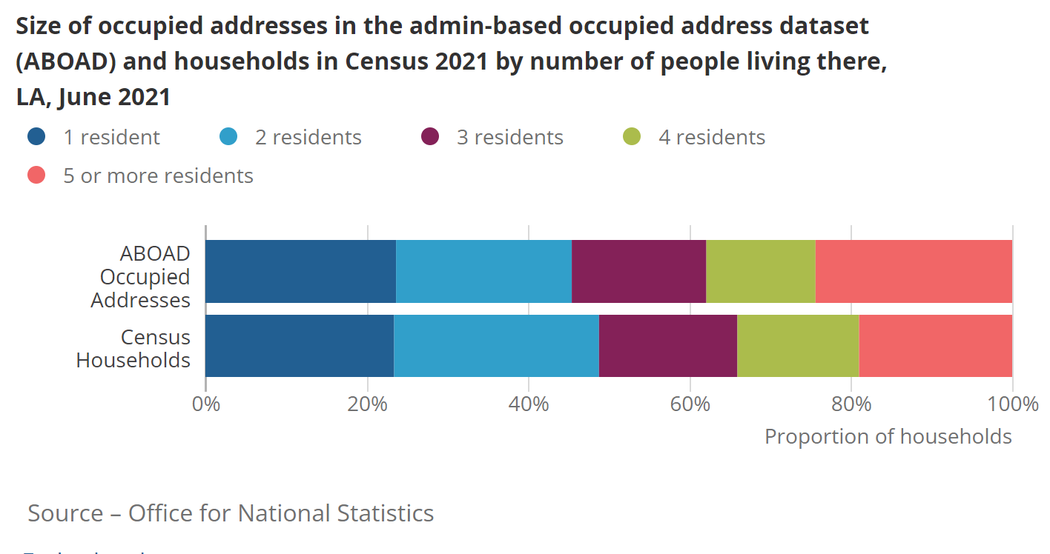
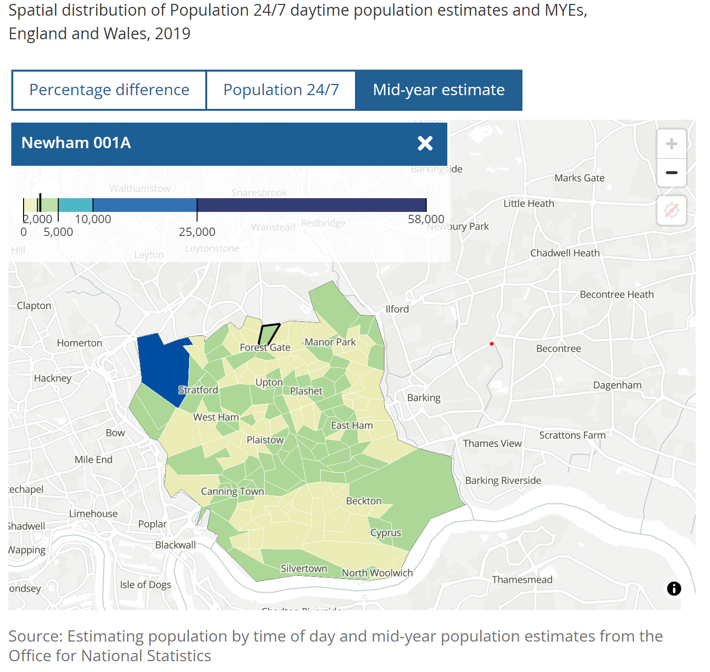
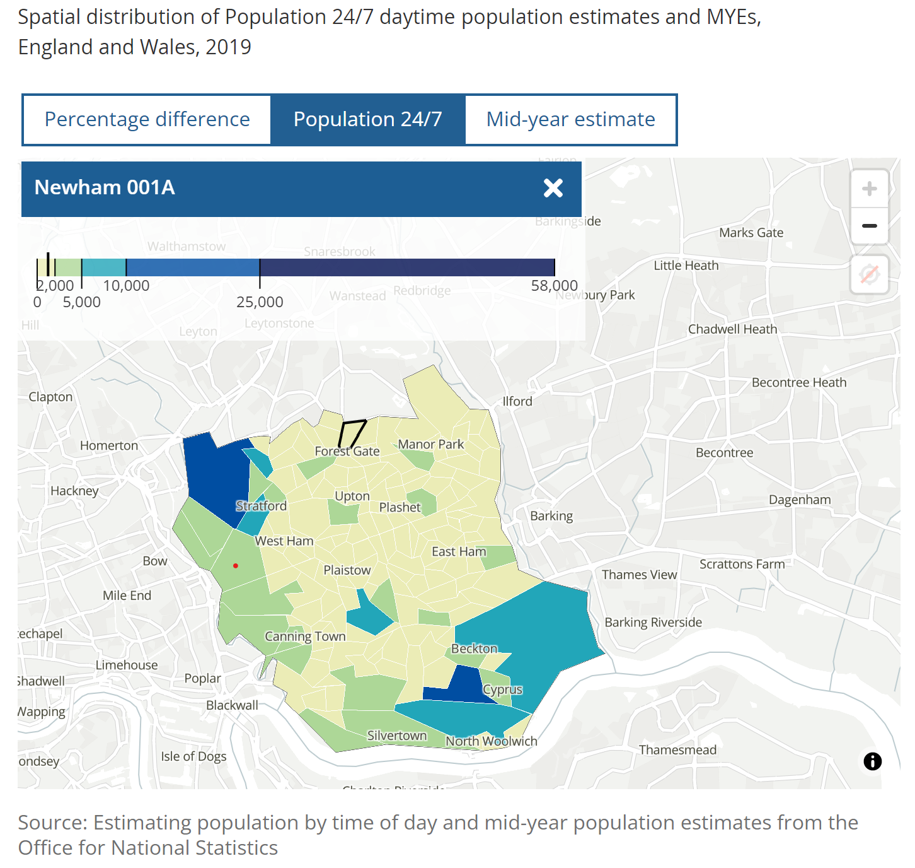

Admin-based occupied addresses and alternative population bases (Newham)
This innovative research showing how population changes from where people usually live (on the left) to where people move to during the day (on the right). Larger populations are seen during the day in areas with commercial and business parks, airports and universities. We will explore how other data sources, like mobile phone data can enhance these estimates.
Admin-based occupied addresses by size compares relatively well to 2021 Census household size estimates. We see some variation in larger household sizes on admin data compared to the survey definition.

Slide 23


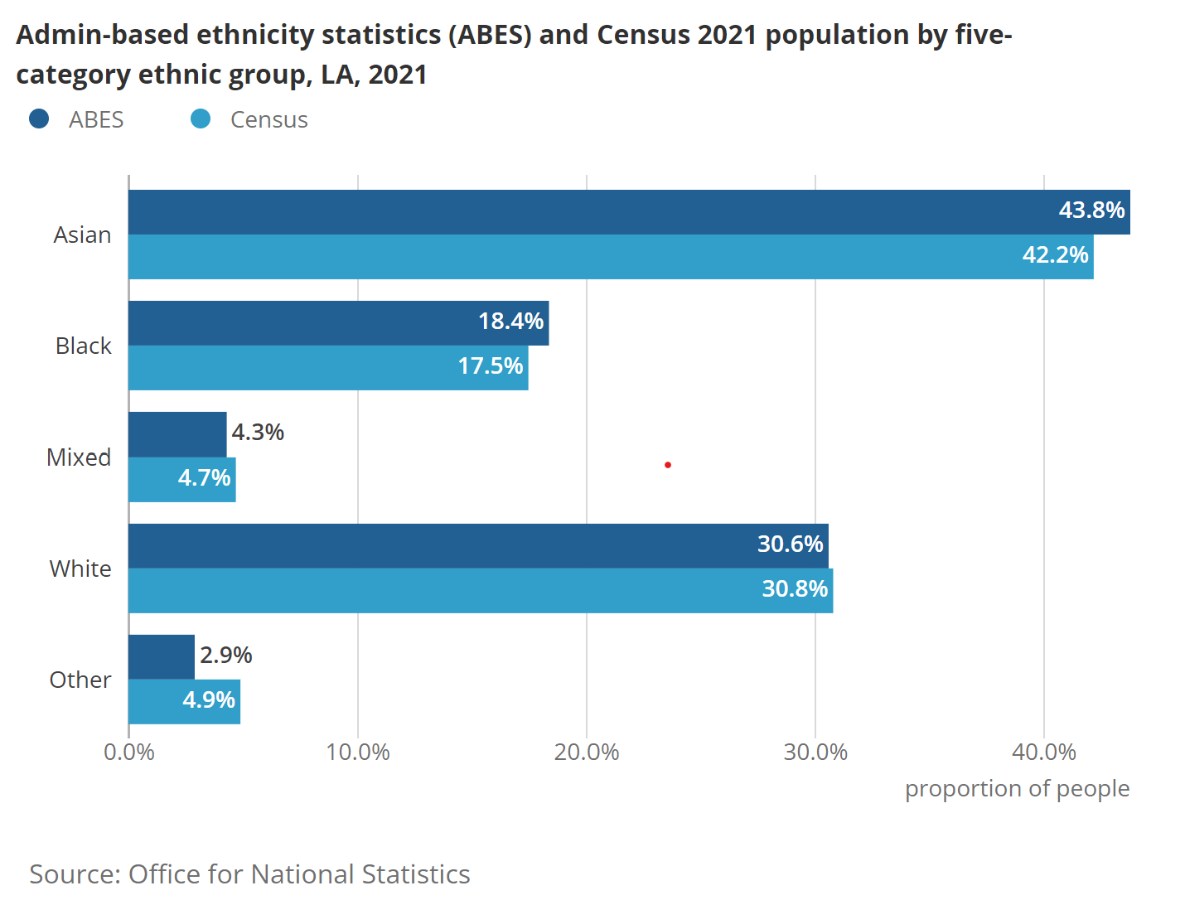
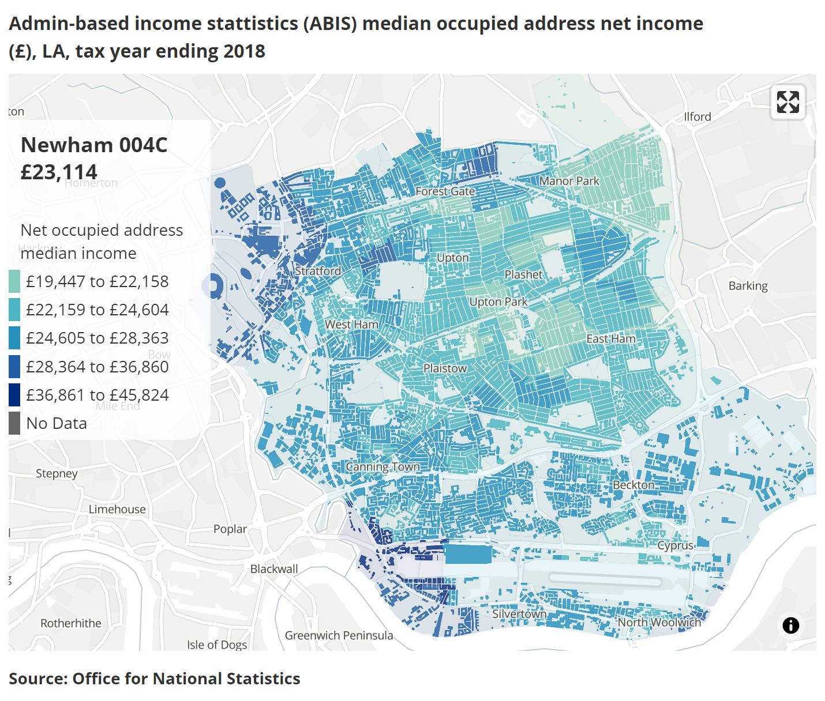

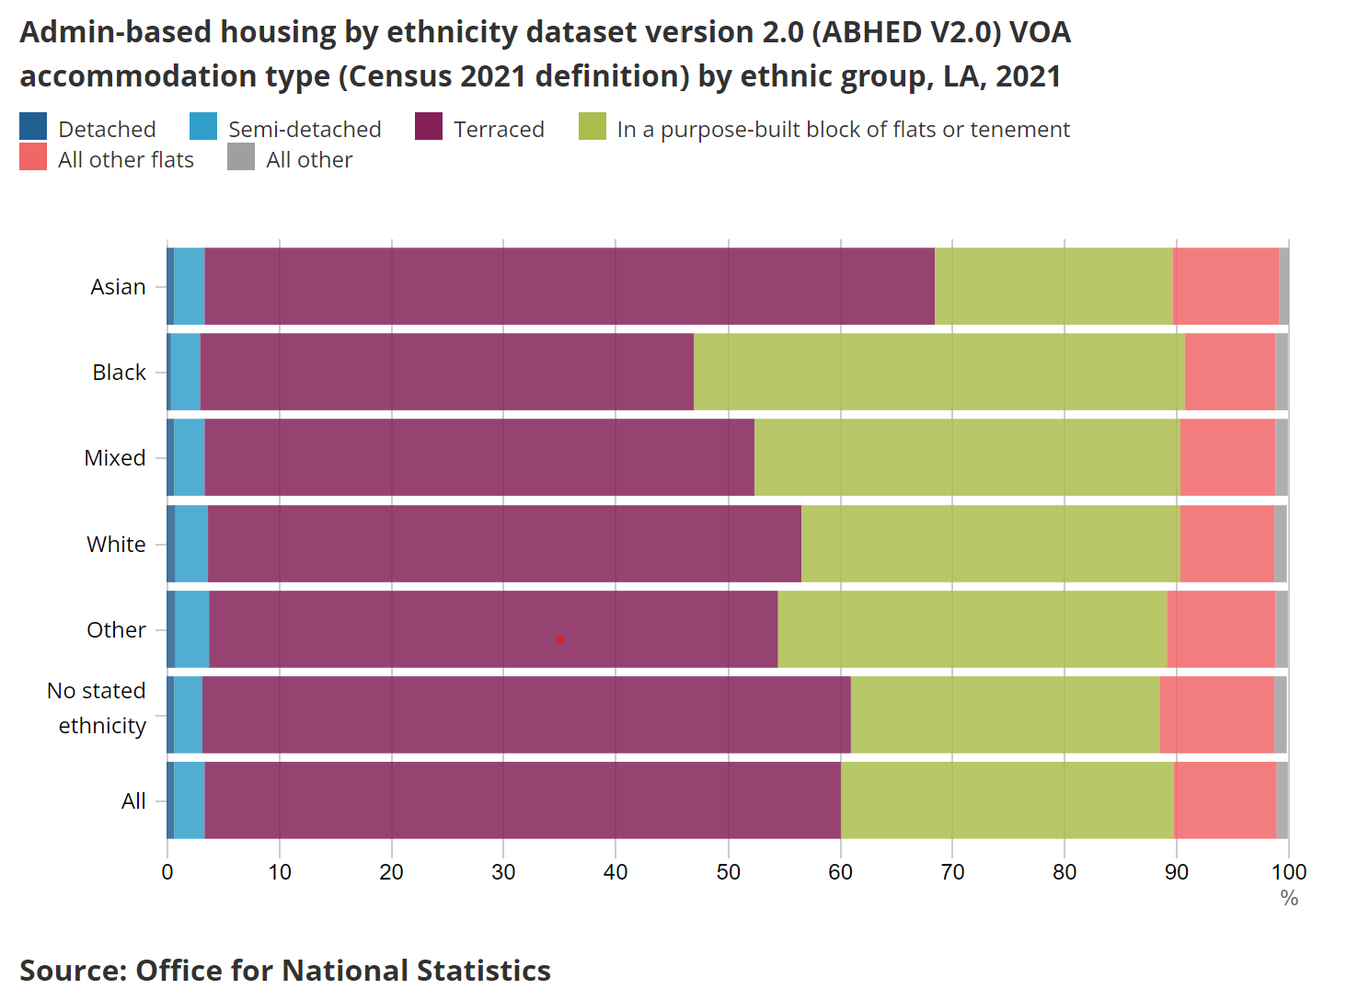
Estimates of how and where we live and the make-up of our communities (Newham)
We have cross-tabulated information about ethnic group with data about housing information such as housing type (as shown here). This illustrates that those identifying as Asian are more likely to live in terraced accommodation than other ethnic groups.
Admin-based ethnic group estimates are broadly comparable with 2021 Census estimates. We will continue to explore differences and look to use other data and methods to adjust for coverage gaps.
Our admin-based income statistics show local differences in the median occupied address net income. Areas like Stratford and Canning Town in the west are more affluent than areas in the east.

Slide 24
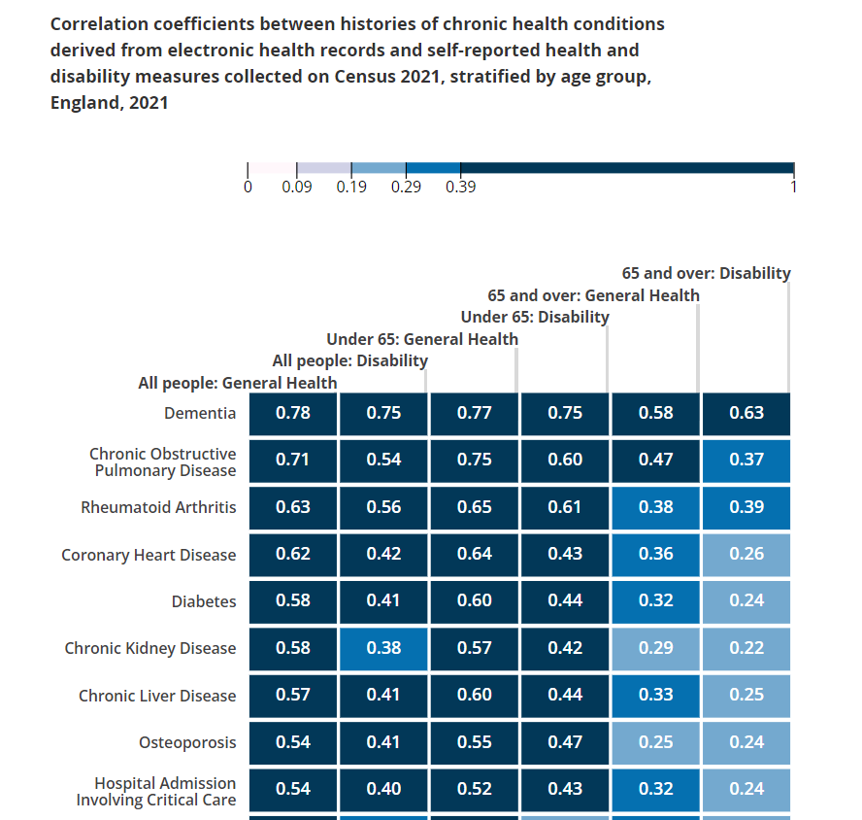
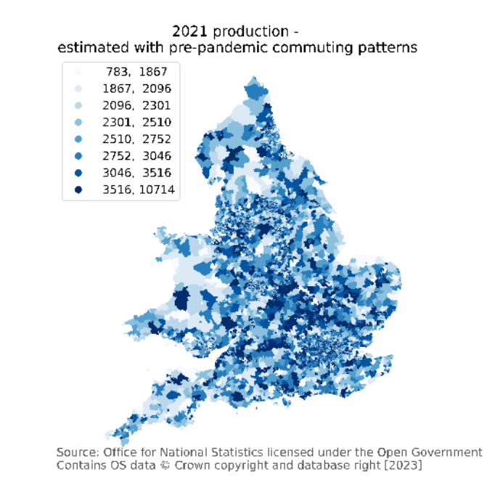
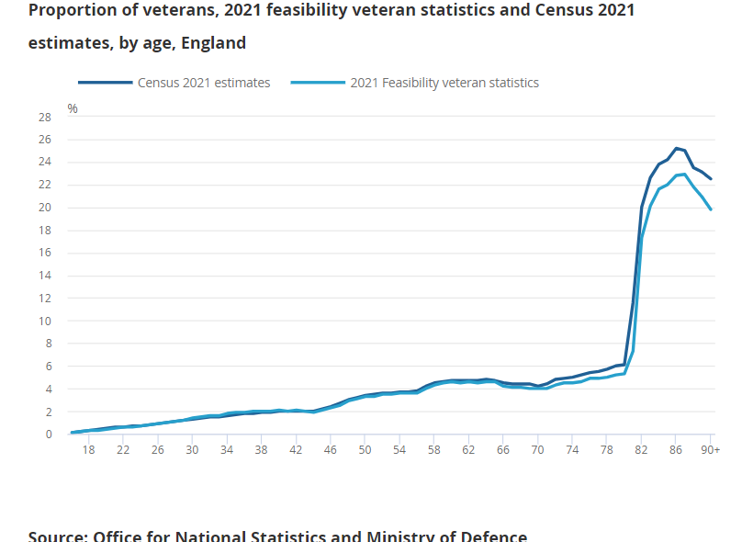
Other characteristics of the population
Modelled travel to work estimates by MSOA in 2021 using pre pandemic travel behaviours. 76% of working adults travel to place of work using these assumptions compared with 54% of working adults in the Census estimates (mid pandemic)
The proportion of veterans in the admin-based veterans statistics are similar to Census 2021 across all age groups
There was a positive association admin-based health measures (electronic health records) and self reported health and disability measures collected on Census 2021

Slide 25
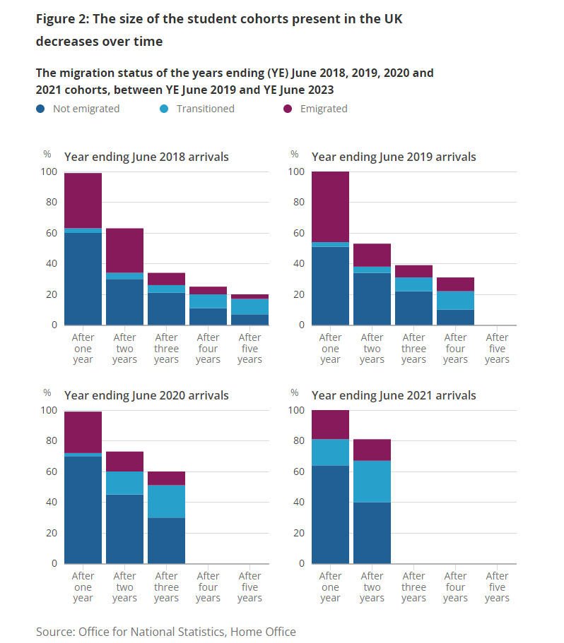
Migration Statistics
YE June 2018 cohort, 17% still present in the country after five years.
Higher proportion of international students transitioning to a different vis type then emigrating in more recent cohorts.
Reason for international migration, international students update - Office for National Statistics (ons.gov.uk)

Slide 26
Benefits of this future system
More timely initial estimates e.g. mid-2023 estimates were published in December 2023 (published as statistics in development)
Improvements in international migration estimates, moving away from the International Passenger Survey and from intentions to behaviours
The new approach should reduce the drift we have historically seen in mid-year estimates (MYEs) as we move further from a Census.
Draws on multiple sources of data to build consistency and resilience

Slide 27
Public consultation
To understand how close our proposed system is to meeting user's needs:
    How does the proposal meet/not meet your needs?
    What you need
    Why you need it
To understand the future requirements of users to inform and prioritise our research plans
To hear from a wide range of respondents
Notes:
A key purpose of the consultation is to identify how well our proposals (including the research we have published) meet user needs and if not, where and why not. And we fully expect we will need to undertake further research as to how to meet needs expressed in the consultation.
Understanding user views and why the information is needed is key to shaping priorities for our further research. They are also crucial in shaping the National Statistician’s recommendation and the further investment needed to meet those needs, however they are met. So we are keen to emphasize to all to please respond so we have as full a picture of those user views as possible, and we will be doing out utmost to drive a wide range of responses to the consultation.

Slide 28
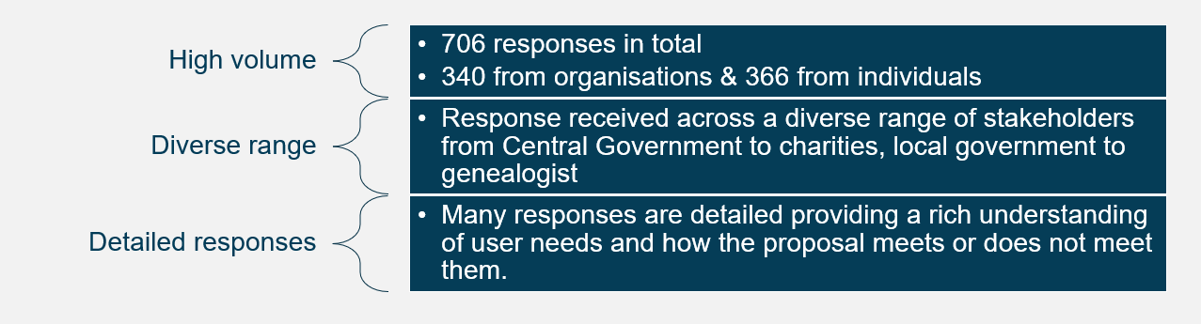
Consultation responses

Slide 29
How does the proposal meet user needs?
Percentage of response
To note: these are interim findings that are still to be quality assured by moderation panel.

Slide 30
Next steps
Complete analysis of consultation responses
Agree National Statistician's recommendation on Future of Population and Migration Statistics
Develop future research plans, prioritised against user needs
Operationalise methods

Slide 31
Any questions?

