Slide 1


Slide 2



Session 3:
Panel Commentary & Open Forum
Panelist:
Helen Russell, Research Professor at the
Economic and Social Research Institute

Slide 3
Future of how Censuses are Conducted in Ireland – insights for providing evidence for policy making
DATE
February 1, 2024
VENUE
National Statistics Board Seminar,
Dublin Castle
PANELLIST
Helen Russell
Notes:
Note research funded by DCEDIY as part of a research programme on children and young people

Slide 4
Using the census to provide evidence for policy
Equality data: micro-analysis of economic & social outcomes
Demographic projections - macro analysis
Community level explanation of social outcomes
Will alternate options provide the evidence needed?

Slide 5

Census as a source of equality data: research on social and economic outcomes

Slide 6




Census is a key source of equality data
Identifies protected groups under equality and human rights legislation
E.g. Ethnicity (including Travellers), nationality, country of birth, religion, disability (detailed disability type)
Not covered in other sources or too few cases
Important basis for studies of migrant integration
Need identifiers but also outcome measures
Notes:
- these groups are often disadvantaged and therefore crucial to

Slide 7
Strengths of Census data
Disaggregation – e.g. Often obliged to combine nationality groups with very different experiences
Intersectionality – individuals occupy multiple statuses (small Ns)
Links individuals and their households
Outcomes - housing situation, labour market situation, family composition residential segregation, education, language ability, social class
Coverage extremely high – includes those in collective settings, multiple languages.
Consistency over time – not affected by administrative changes eg eligibility changes in benefit statistics
Area characteristics - SAPs, regional analysis
Notes:
- links indiv and households – economic and social outcomes to a large extent determined by our family (not individual)
- due to extensive efforts of the enumerators and the CSO has incomparable coverage - we have used the Census for example to study structurally vulnerable groups tha
have used to examine composition of the homeless population Address misperceptions

Slide 8

Census as a source for demographic projections

Slide 9
Census is a key source for demographic projections
ESRI produces national & regional demographic projections, used for
- Housing demand
- Health care demand
- Educational demand e.g. early-education and childcare (AIM programme)
- Energy demand
- Macro modelling (COSMO)

Slide 10


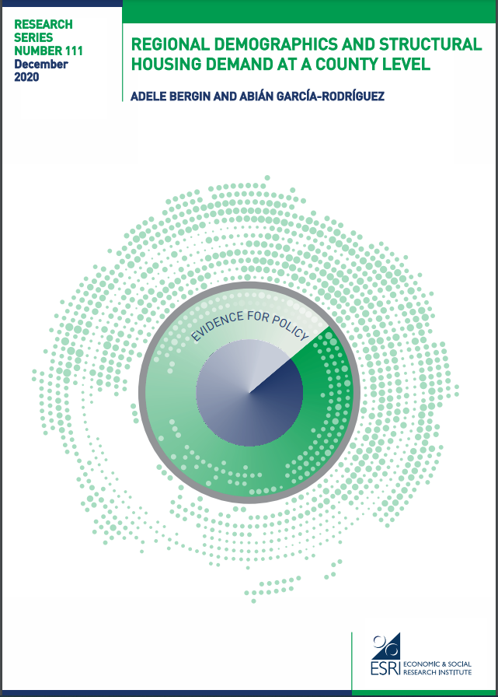

Slide 11
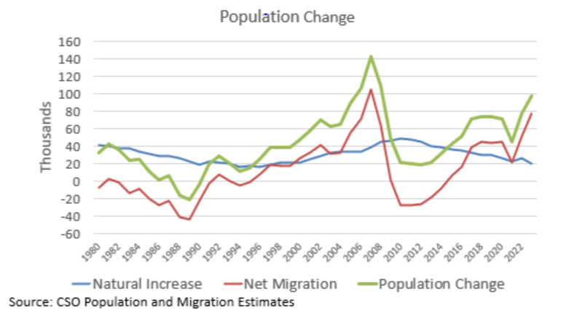
Migration statistics crucial for demographic projections
Migration main driver of demographic change in Ireland
Changes rapidly – numbers and composition
Migrants sig % of the pop in Ire
Population and Migration Estimates require significant correction on the basis of 5yr Census
Age of migrants mean they are a key group for housing demand, labour demand etc.

Slide 12
Alternatives - IPEADS & Irish Community Survey

Slide 13

IPEADS
Advantages – cost, frequency, reduced respondent burden (?)
Demographic projections – key requirement is for accurate estimates of migrant population at a county level
10 year window v. wide in changing context if admin estimates need correcting as currently the case
Equality Analysis
  Identifiers not included in IPEADS - ethnicity, disability, household attributes or marital status, religion (and not included in many admin sources)
  potential inconsistencies in definitions/changing criteria in admin sources
  Outcomes not included - housing characteristics, education, social class, local area characteristics (SAPs), language…
  Currently unclear if these can be sourced from elsewhere
Notes:
including internal migration

Slide 14
Irish Community Survey
Mandatory survey - addresses issue of lower response rates
Proposed 6,000 hh per month - 72k per year if unique cross-sectional samples
  Circa- 197k individuals per year
LFS 32.5k hhs per quarter – 128k per year (not unique, panel element)
    Achieved sample considerably lower, 12.5k hh per quarter 2023
Large enough to identify some groups but not others (e.g. Travellers), disaggregation still an issue
  Possibility of booster samples?
Those not living in private households excluded (e.g. Ukranians, homeless)
Important to include all key identifiers for protected groups & outcomes not collected elsewhere
Results from Census used to the reweight the LFS results
Notes:
eg – EU east, Eu west,

Slide 15
Session 3:
Panel Commentary & Open Forum
Panelist:
Martin Quigley, Director of Data and Analytics at Pobal

Slide 16
Census data for resource allocation
The Pobal HP Deprivation Index
Martin Quigley, Director of Data & Analytics
01/02/2024

Slide 17
Pobal
Established in 1992 as Area Development Management (ADM)
Manages programmes and funding on behalf of Government
Distributed €1.2b across 42 programmes and in 2023
Supports programme design and implementation using a range of evidence, tools and techniques

Slide 18
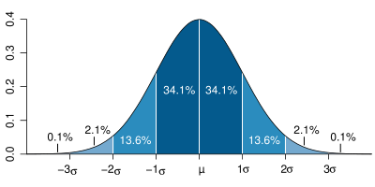
What is the Pobal HP Deprivation Index?
A tool to identify geographic disadvantage based on census data
Available on Pobal Maps
Used by us, other Departments & State Agencies and researchers
Data available for download at Electoral Division level on data.gov.ie, and at Small Area level on license with authors

Slide 19
Definition
The fundamental implication of the term deprivation is of an absence – of essential or desirable attributes, possessions and opportunities which are considered no more than the minimum by that society.
(Coombes et al., 1995)
Notes:
A key innovation with respect to the UK context is that we focus on the aggregate properties of local populations

Slide 20
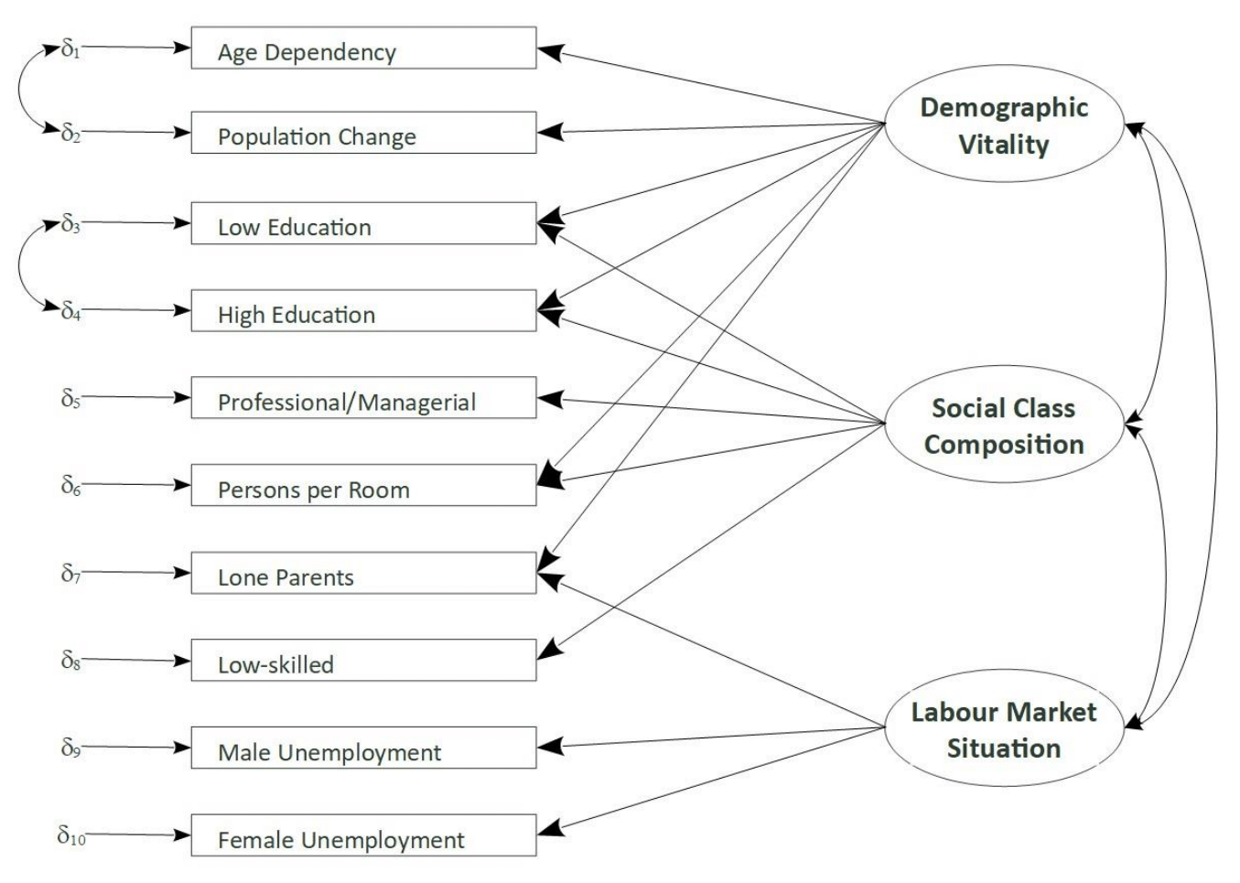
Structure
& Measures

Slide 21
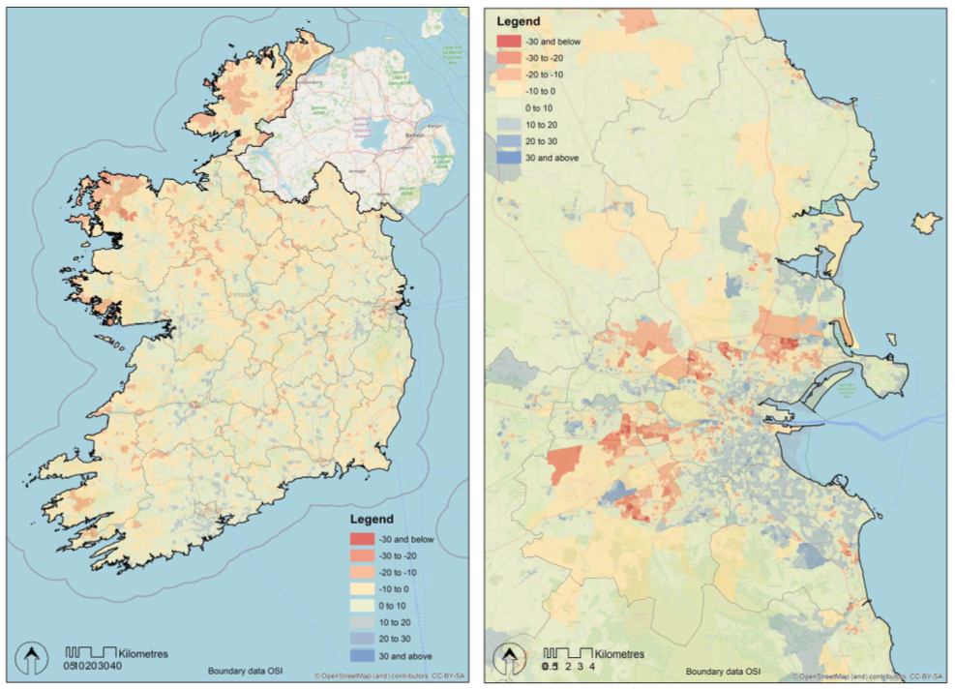
The Pobal HP Deprivation Index

Slide 22
What levels does it work at?
The larger the geographic area, the less likely that individuals will share common socio-economic characteristics
County, Local Authority - Commonly used boundaries but so large that averages tend towards 0.
Local Electoral Areas
Electoral Division – commonly used, but vary greatly in size (43,905 – 7)
Small Area – circa 100 households – primary usage at this level

Slide 23
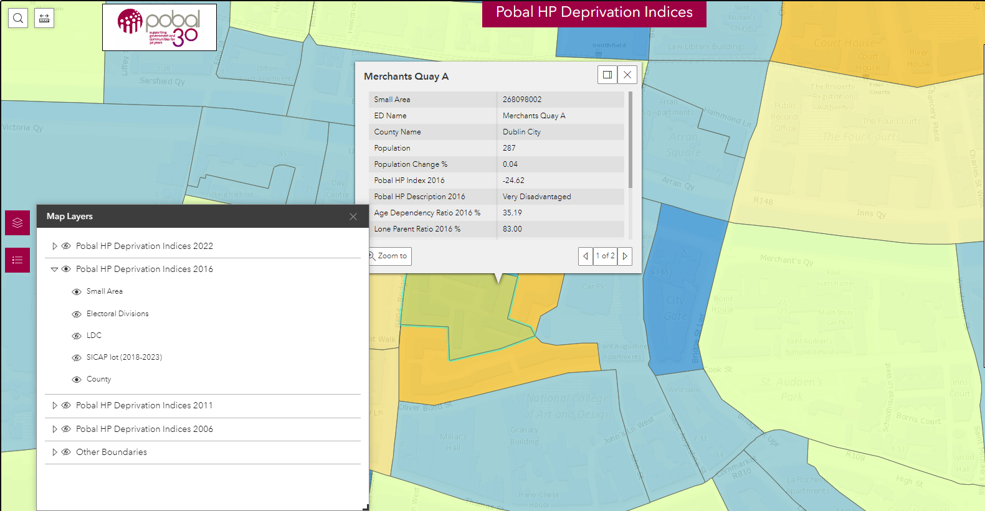

Slide 24
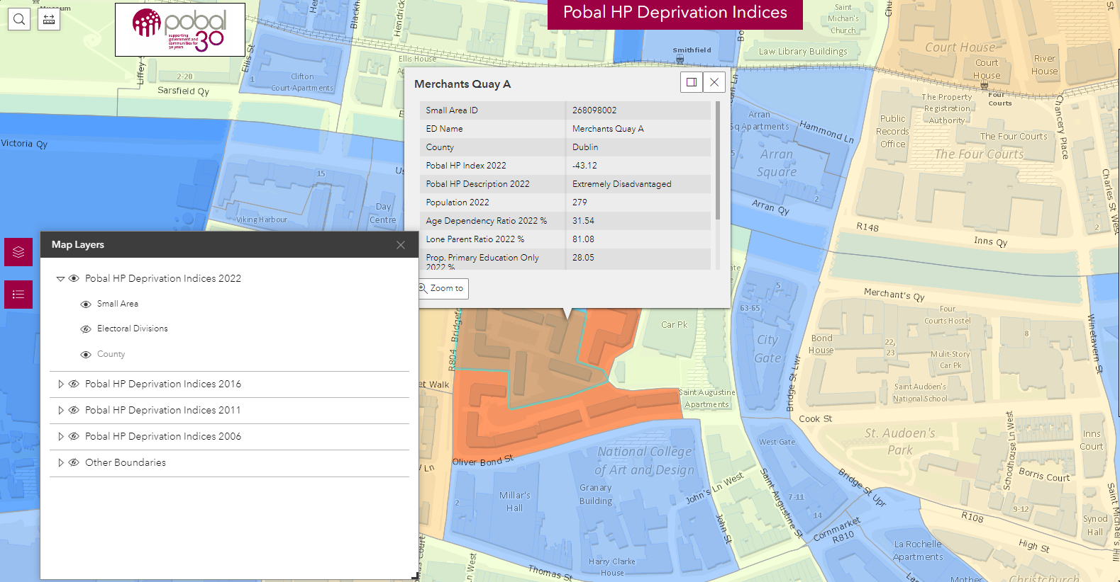

Slide 25
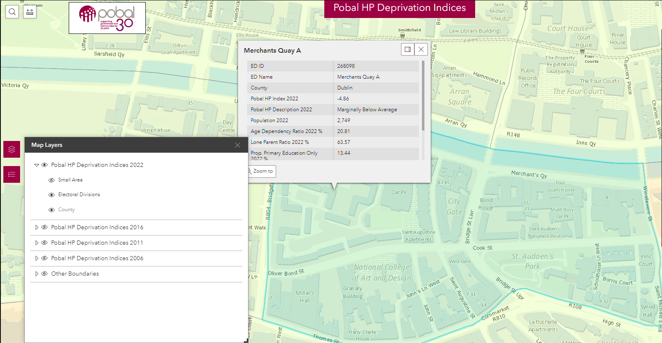

Slide 26
Resource Allocation
Usage
Others
SICAP, LEADER
HEA funding model
CCC funding
DEIS School Designation
HSE Resource Allocation
Sports Capital
Equal Participation Model
CSO Sampling
Local Property Tax
SOLAS FE monitoring
CSP Appraisals
Policy analysis
HRB – NDTRS
Research in hospitals, universities, institutes etc.

Slide 27
Education
- DEIS Identification: Schools designated DEIS status based on Small Area Deprivation scores of children's addresses.
- HEA: One of several criteria for targeted third level grants
- Equal Participation Model (in development): Identify Early Learning and Care settings with concentration of children from Disadvantages Small Areas.

Slide 28
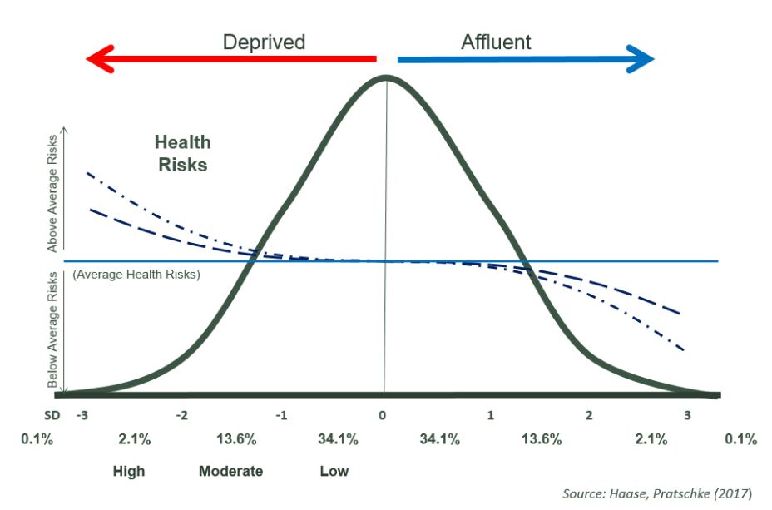
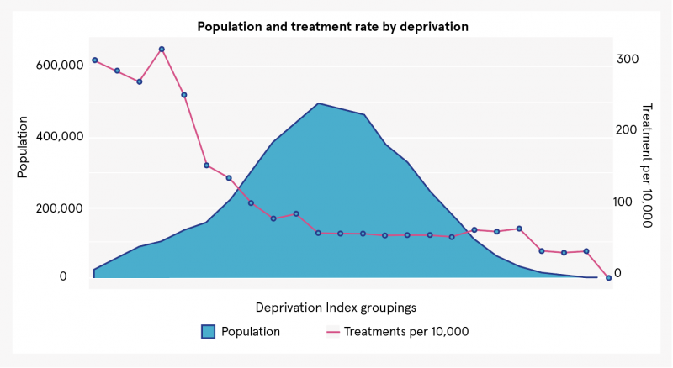
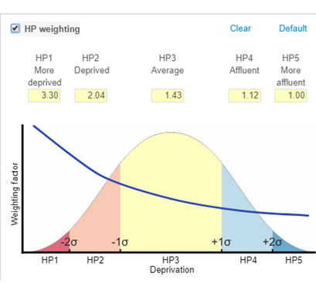
Health

Slide 29
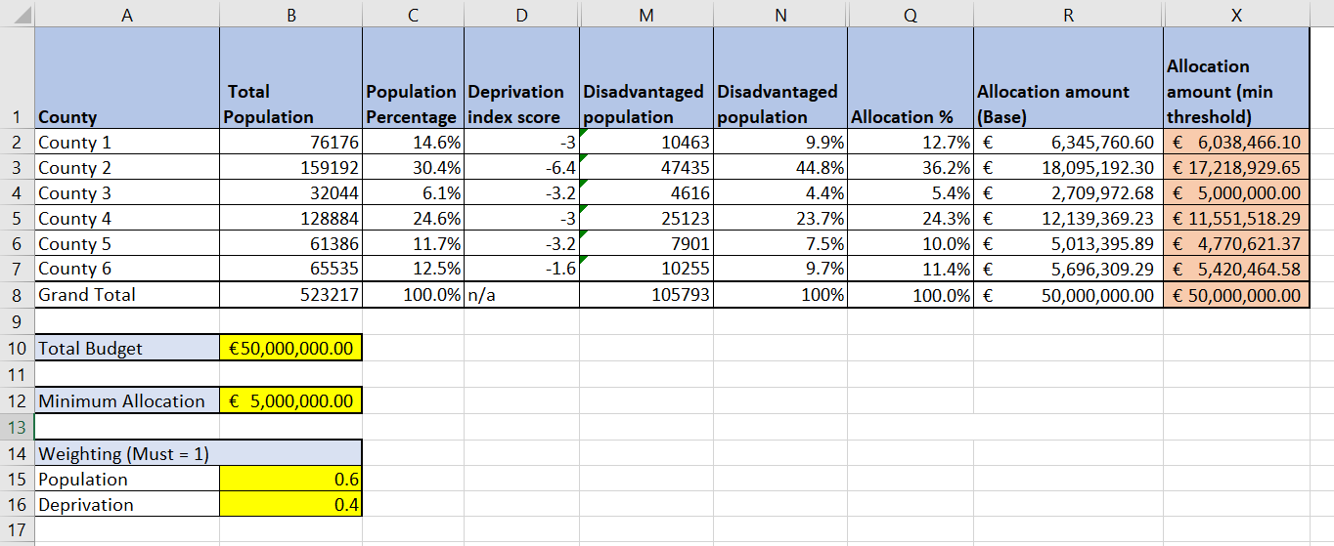
Social Inclusion - Resource Allocation Models
Notes:
Spell out first line

Slide 30
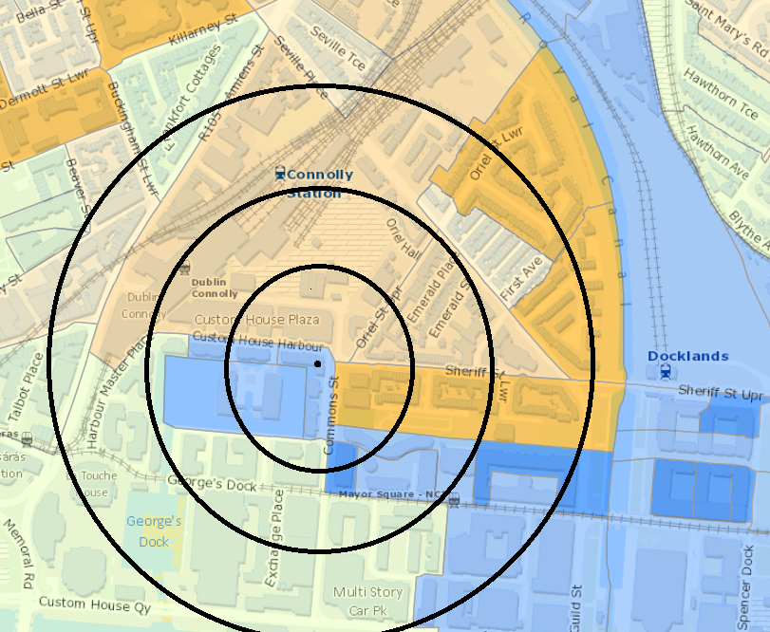
Setting specific scoring
Where each applicant is given a score as part of appraisal process
Can be score of boundary, or bespoke calculation
Challenges when used too simplistically

Slide 31
Concluding thoughts:
Opportunities
- Usage of existing data
- More timely information
- Assess options through lens of Equality Impact Assessment
Risks
- Less granularity of all important community level (Small Area) metrics
- Reduction in state’s ability to target resources at most in need communities
- Loosing quinquennial snapshots of consistent data points for trend analysis

Slide 32
Further reading
More info
  Conceptual Model and technical description
  Pobal Maps
  Electoral Division level dataset
  Informal enquiries or access to Small Area level data – pobalmaps@pobal.ie
Notes:
Spell out first line

Slide 33
Session 3:
Panel Commentary & Open Forum
Panelist:
Catriona Crowe, Archivist and Broadcaster

Slide 34
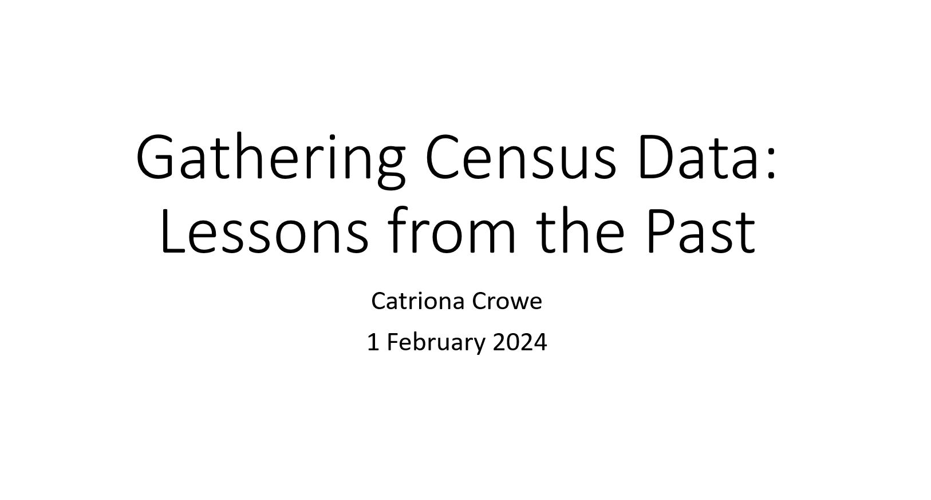

Slide 35
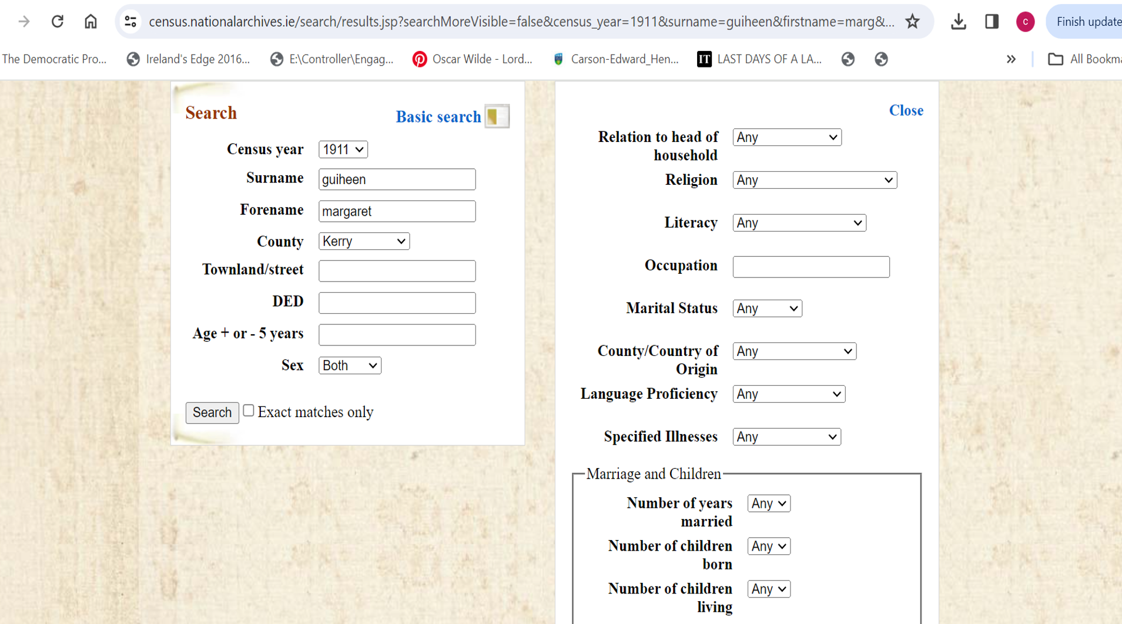

Slide 36


Slide 37


Slide 38


Slide 39
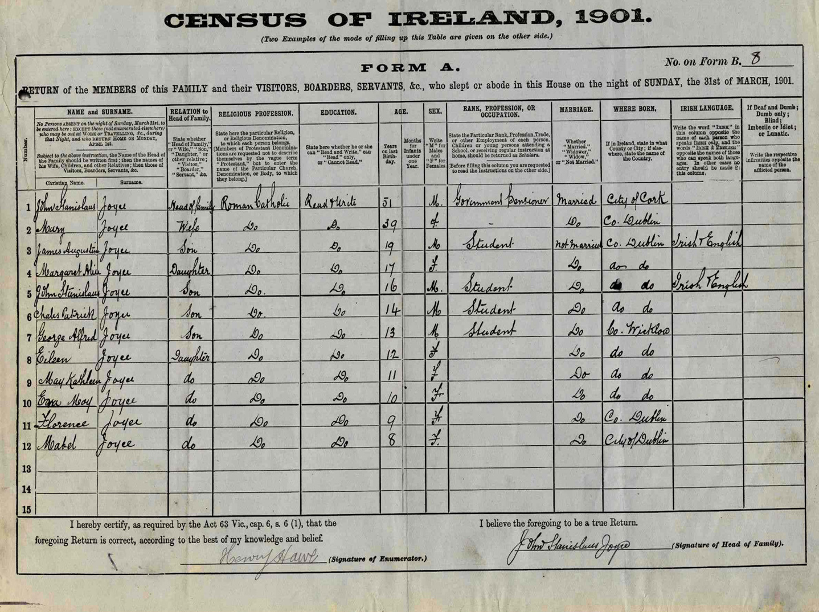

Slide 40


Slide 41
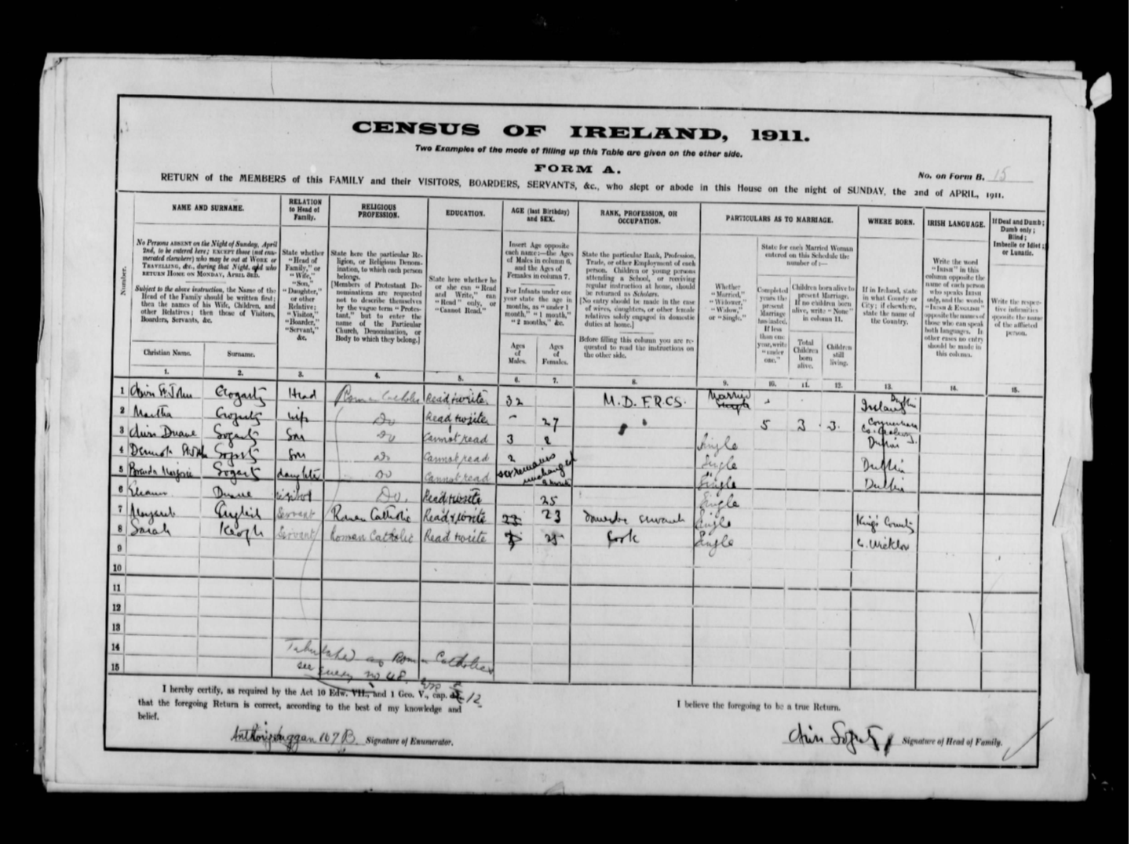

Slide 42
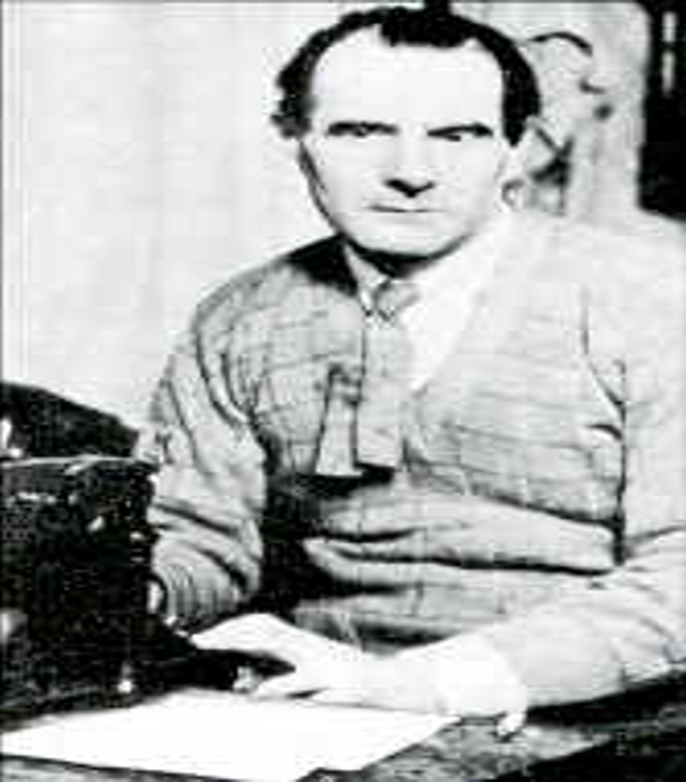

Slide 43
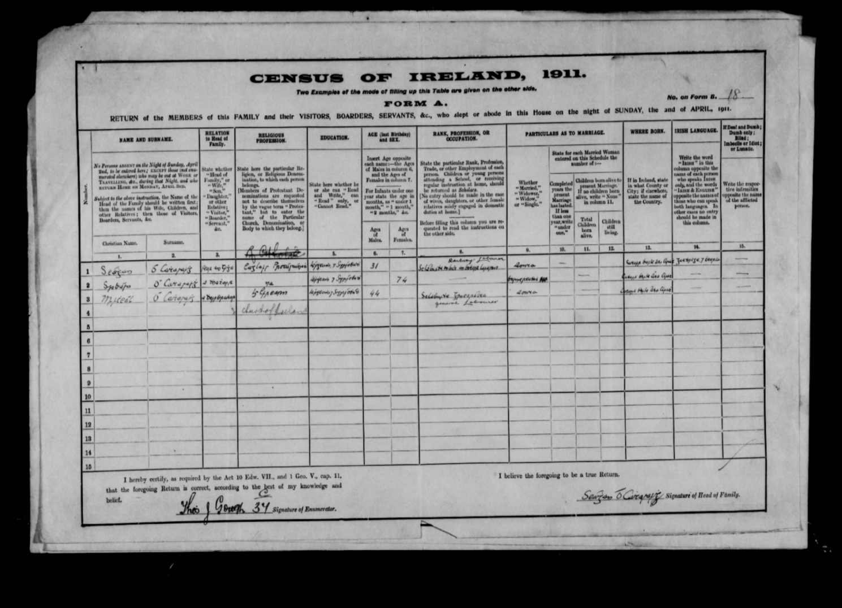

Slide 44
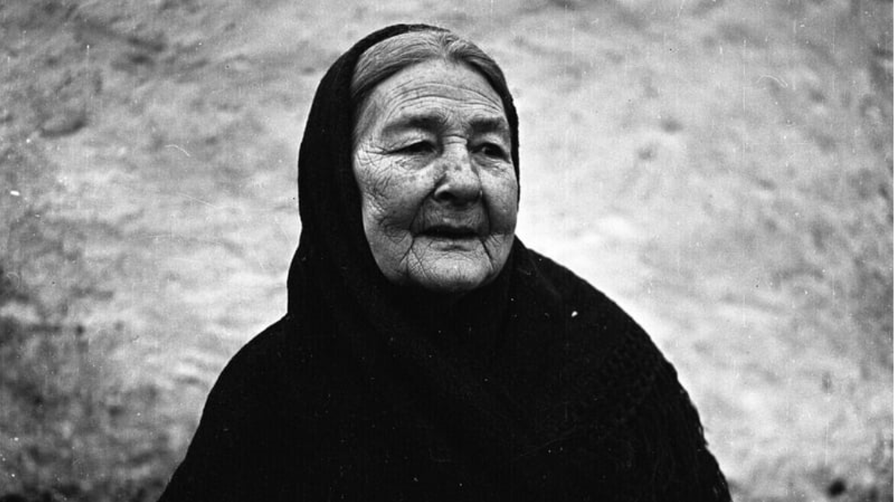

Slide 45
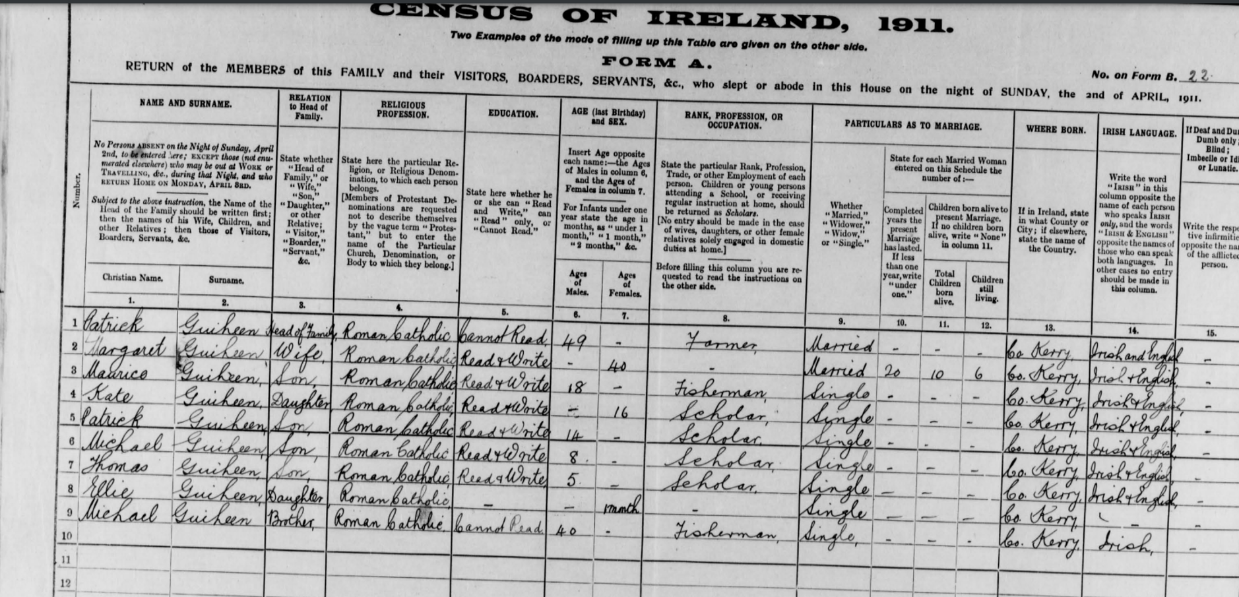

Slide 46


Slide 47


Slide 48


Slide 49


Slide 50
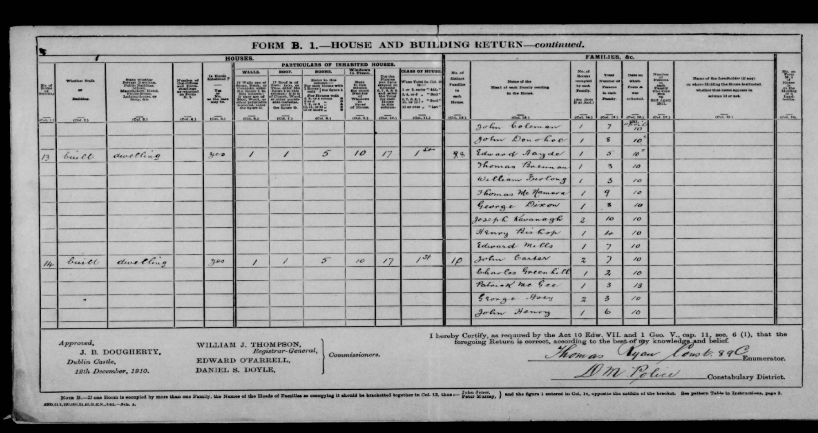

Slide 51
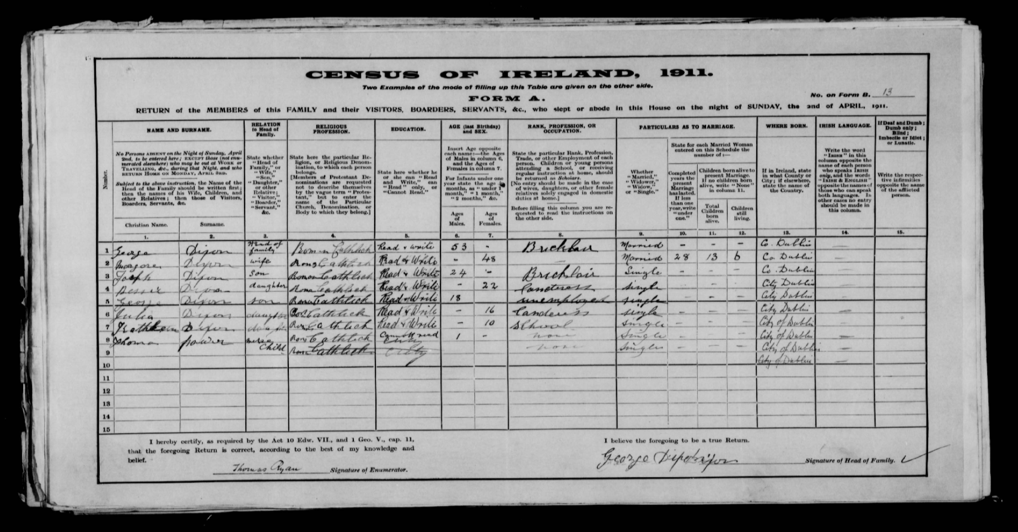

Slide 52
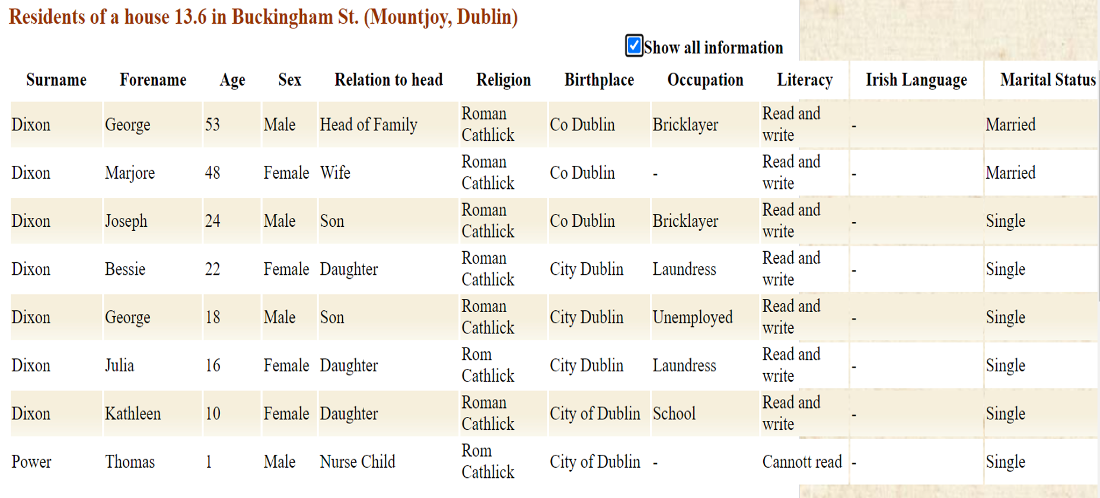

Slide 53
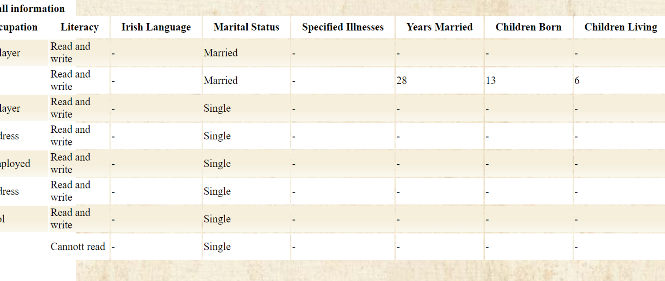

Slide 54
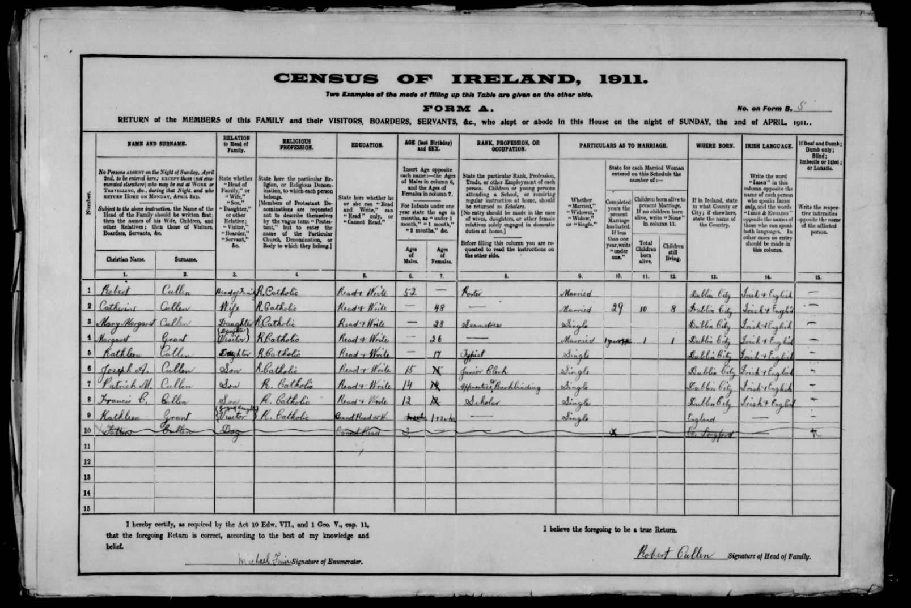

Slide 55
Session 3:
Panel Commentary & Open Forum
Questions from the floor and Slido
for the Panel and Speakers

